Slide 1


M&M Rounds
Background
August 2025

Slide 2
Confidentiality Statement
We need to protect the privacy of patients
These rounds are strictly confidential
No patient initials, dates, times or names of staff involved will appear in this presentation.
Goal of M&M Rounds
To improve the quality of care and patient safety outcomes

Slide 3
M&M rounds
Historically
  Identify errors
  Punitive process
The Ottawa M&M model
  Standardized approach
  Learning opportunity
  Protected discussion
  Medical education
  Quality improvement
  Risk management

Slide 4
M&M in Island Health
Pilot project across Island Health
Following the Ottawa M&M model
The Health Authority Medical Advisory Committee (HAMAC) subcommittee
  “…to support a standardized approach to learn from clinical experiences and raise quality and safety issues through the organization”

Slide 5
Cases appropriate for M&M rounds
Require all 3 of the following:
Adverse outcome such as death, disability, harm, injury, or a near miss (potential harm avoided – for example, a patient given incorrect medication due to mislabeling of syringe – potential for harm but the patient ultimately wasn’t affected)
Preventable
Lessons to be learned about cognitive biases and/or system issues
In this model, cases are presented by those who were involved directly, not reviewed by a third party. This format is different from critical incident analysis framework, although may be used as an adjunct.

Slide 6
System factors
System-level issues often relate to problem(s) beyond just the individual clinician or team, and pertains to how your clinical setting operates:
    Patient factors
    Skill-set errors
    Task-based errors
    Personal impairment
    Teamwork failure
    Local environmental contributors
    Hospital-wide contributors
    Hospital administration contributors
    External contributors

Slide 7
Cognitive Bias
Clinical decision-making is an extremely complex process, and healthcare
professionals often develop adaptive mechanisms (referred to as heuristics)
because we are faced with repeated similar experiences in a busy clinical
environment.
  Type 1 – subconscious: fast, intuitive
  Type 2 - analytical slow
Goal: become aware of how we use our cognitive systems, to hopefully mitigate biases going forward.

Slide 8
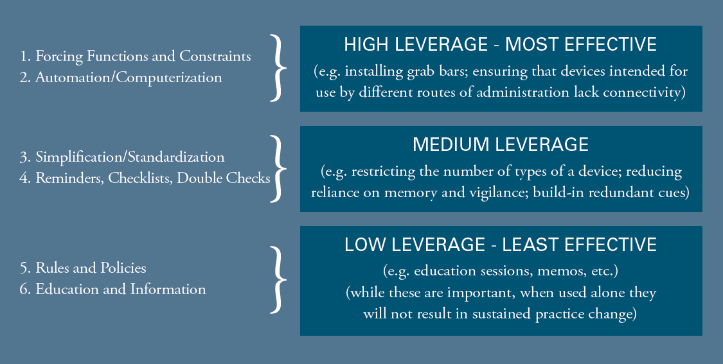
Hierarchy of Effectiveness
Notes:
The hierarchy of effectiveness is used to describe the changes we put in place to lead to improvement and the relative impact they have. At the bottom of the “hierarchy” are person-based solutions which are easier to put in place and commonly used. At the top are the most effective and most constraining but harder to put in place and require development of infrastructure.

Slide 9
Typical M&M case structure
For a 30-minute M&M presentation:
  10 minutes for review of the case and state of evidence on current management
  10 minutes for case analysis in terms of cognitive and system issues
  10 minutes for discussion, review of bottom lines and consensus on potential action items

Slide 10
Section 51 Protection
Purpose is for learning and improvement
  within hospital, mental health facility or ambulance during transfer
Conducted under approved council/committee
Opinion is protected
Fact is not protected
Notes:
Section 51 is a section of the BC Evidence Act that prohibits the disclosure of opinion and documentation collected as part of Quality Review by a designated Quality Committee. Such information cannot be admitted into evidence in any legal or civil proceedings or disclosed beyond the Health Authority Board of Directors and health care professionals.
The intent of the Section 51 is to promote open and frank discussions among health care professionals about all of the factors and circumstances leading to a patient safety incident or unanticipated patient outcome, for the purpose of improving care delivery. This supports Island Health’s commitment to a relentless focus on learning and improvement.
To be protected under Section 51, quality reviews must be conducted by a Quality Committee constituted within the Island Health Quality Structures as designated by the Island Health Board of Directors. In addition, Section 51 protection applies only to the review of care provided within a hospital, provincial mental health facility, or during transportation of patients by BC Emergency Health Services.
Information protected under Section 51:
Opinions and interpretations of any individuals who participate in a Quality Review.
All documentation arising from the Quality Review, including
Interview reports
Evaluations
Audit results
Review reports and summaries
Recommendations that have not been implemented.
Note: Once approved, recommendations will be released to individuals within the organization who need to be aware of, or act on, the recommendations
Information not protected under Section 51:
Facts pertaining to the patient’s care including
Details of the incident affecting the patient
Patient’s health status
Patient’s course of treatment and care
Any information in the patient record
The fact that a Quality Review was conducted
Quality Reviews related to care provided in the community or in facilities other than hospitals or provincial mental health facilitiesOpinions and documentation gathered by any individual(s) not working within a properly constituted Quality Committee
Recommendations that have been implemented within the organization

Slide 11
CME
CME
Attending M&M rounds can be claimed as a CME activity
RCPSC
  MOC Section 1 credits for group learning (not accredited)
  MOC Section 3 credits for improvement activities
CCFP
  Mainpro+

Slide 12
What next
Local bottom line/action items to be forwarded to the most appropriate Clinical Governance structure, as identified for section 51 protection. This may be a local-level Clinical Governance structure or C.A.R.E. Network committee
  Aim for feedback from clinical governance structure to be brought back to the M&M group within 3 months
Where applicable, local actions to be initiated
  Bottom Line/Action item slide to be shared with all M&M group members
  Feedback to be brought to the M&M group within 3 months

Slide 13




Sharing recommendations
STEP ONE:
Case Discussed at M&M Rounds
A case is discussed at M&M Rounds: cognitive bias and/or systems issues are identified.
The group decides collaboratively what changes need to occur. Local change is actioned where possible.
STEP TWO:
Bottom line/Action items
The Facilitator shares bottom line/action items:
  With group members
  Relevant local-level clinical governance and/or C.A.R.E. Network structure
STEP THREE:
Report out
STEP FOUR
Feedback
Aim to obtain feedback from Clinical Governance structure within 3 months and share an update at your M&M rounds.

