Slide 1
ADHD - old name, new ideas
Marie-Claude Grégoire MD MSc FRCPC
marie-claude.gregoire@islandhealth.ca
July 2024

Slide 2
Objectives
- Review the current diagnostic criteria
- Explore the demographics (does everyone has ADHD now?)
- Clinical diagnostic tools
- Approches to management: the 3 Ps
- Have a discussion about real situations
MCG July 2024

Slide 3
Disclosures
No financial CoIs
However I have lived experience:
- myself
- my son
And most likely others in my family…
MCG July 2024

Slide 4
The DSM-5-TR
Circular logic?
ADHD is a neurodevelopmental disorder defined by impairing levels of inattention, disorganization, and/or hyperactivity-impulsivity. (Why? How?)
Inattention and disorganization entail inability to stay on task, seeming not to listen, and losing materials necessary for tasks, at levels that are inconsistent with age or developmental level.
Hyperactivity-impulsivity entails overactivity, fidgeting, inability to stay seated, intruding into other people's activities, and inability to wait— symptoms that are excessive for age or developmental level.
Symptoms present for > 6 months, before age 12, in 2+ settings, lower QOL
Not exclusively explained by another conditions
MCG July 2024

Slide 5
Hyperactivity-Impulsivity
Often:
fidgets with or taps hands or feet or squirms in seat.
leaves seat in situations when remaining seated is expected
runs about or climbs in situations where it is inappropriate (or feeling restless)
unable to play or take part in leisure activities quietly
“on the go” acting as if “driven by a motor”
talks excessively
blurts out an answer before a question has been completed
has trouble waiting his/her turn
interrupts or intrudes on others
MCG July 2024
https://energizer.com/energizer-bunny/bunny-timeline/

Slide 6
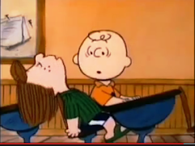
Inattention
« Wah-wah-wah-wah-wah-wah »
Often:
fails to give close attention to details or makes careless mistakes
has difficulty sustaining attention in tasks or play activities
does not seem to listen when spoken to directly
does not follow through on instructions and fails to finish a task
has difficulty organizing tasks and activities
avoids, dislikes, or is reluctant to engage in tasks that require sustained mental effort
loses things necessary for tasks or activities
often easily distracted by extraneous stimuli (or unrelated thoughts)
often forgetful in daily activities
MCG July 2024

Slide 7
Who has ADHD? Clark Kent or Superman?

Slide 8
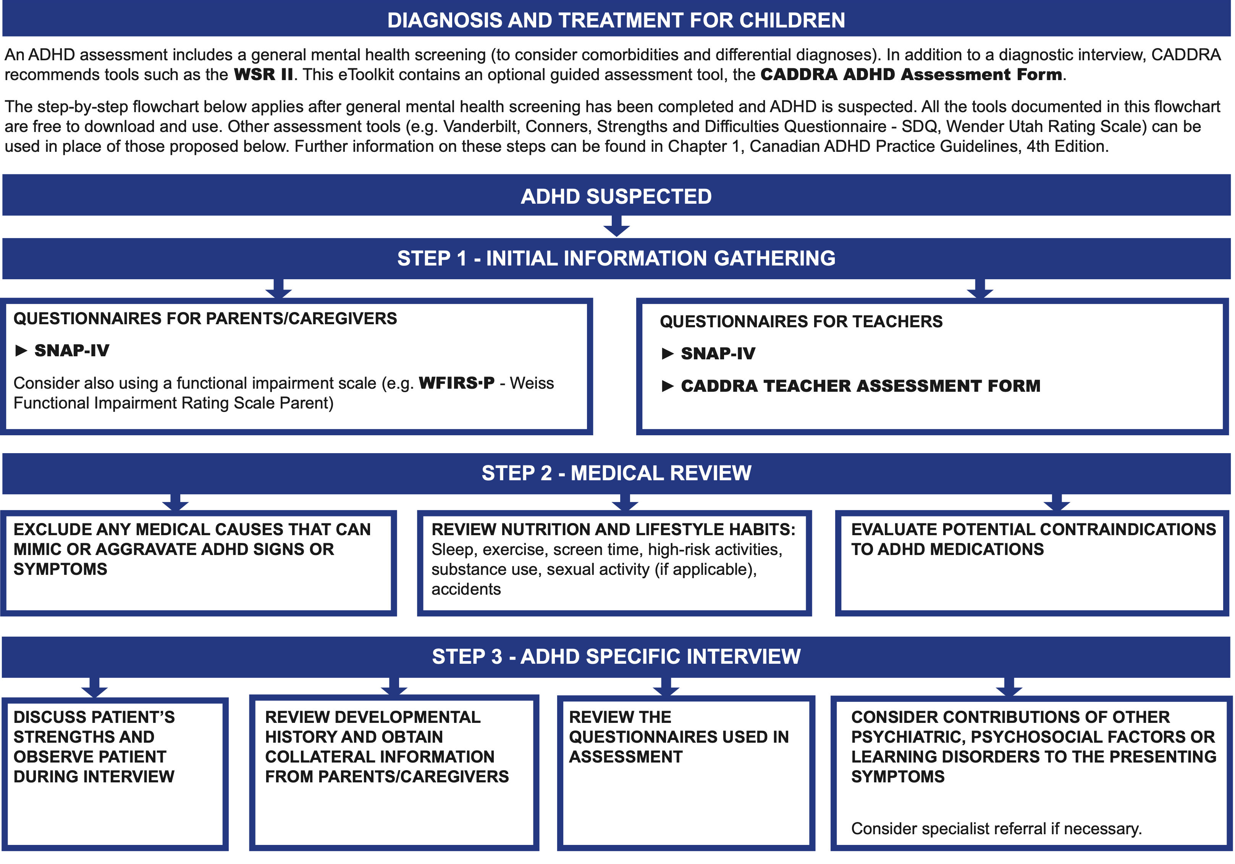
www.caddra.ca/resources/step-by-step-guide-to-adhd
It’s all in
the history…
and
observation.

Slide 9
Treatment - the PPP
Physical: nutrition, sleep, pain, continence, sensorial overload …
Psychological: anxiety, fears, emotional regulation, negative core-beliefs (the ADHD myths and lies)
Pharmacological: the stimulants, the non-stimulant and the co-diagnosis
The first 2 are always essential. The 3rd one? It depends.
Education is fondamental.
MCG July 2024

Slide 10
The stimulants
Not including caffeine!
Amphetamines vs Methylphenidate??
The best medication is the one that provides good symptom relief, optimizes function, without significant adverse effects.
Additional questions:
Can the patient swallow tablets or capsules?
How long is the school day? After school activities?
Any family members treated for ADHD? What went well? Not well?
Any contraindication to stimulants?
And unfortunately: what insurance coverage?
New Liquid
Formulation
coming soon!
MCG July 2024

Slide 11
Thriving with ADHD
Is it possible?
MCG July 2024

Slide 12
Resources
Websites:
CADDRA.ca
CADDAC: Canadian ADHD Awareness | Education | Advocacy
https://keltymentalhealth.ca/adhd
https://www.additudemag.com/ (online magazine)
Attention-Deficit/Hyperactivity Disorder in Children and Youth | Here to Help
https://healthymindslearning.ca/rollingwith-adhd/ (free online course for parents)
https://www.aboutkidshealth.ca/adhd https://www.aboutkidshealth.ca/Article?contentid=1922&language=English
Instagram @ADHD_love
Books:
Smart but Scattered Series by Peg Dawson and Richard Guare
My brain needs glasses by Annick Vincent
Puppy in my head by Elise Gravel (for kids) (in French: Ollie)
Driven to Distraction by Hallowell and Ratey
Sensational Kids – sensory processing disorder by Lucy Jane Miller
The explosive Child (6th edition) By Ross W Greene
For adults: Dirty Laundry & Small talk by Richard & Roxanne Pink
MCG July 2024

Slide 13
Discussion
Image: ADDitude

