Slide 1
Department of Primary Care (Department of Family Physicians) Report to hamac William Cunningham – Department head primary care November 14, 2024

Slide 2
The purpose of this report is:
To assure the HAMAC, CEO and the Board that I and the 1,079 family physicians in whatever domain of care they are credentialed & privileged in, deliver safe, high-quality and effective care.
I can confirm that we are meeting these standards, and where there are gaps, they are being addressed.

Slide 3
It takes a team to deliver high quality care.
In MAA, the departments do the governance component. Operations do the operations.
Add to that the work of the 25,000 colleagues and operations that make up the Island Health total team of care and $4 billion and I think that we are doing a good job.

Slide 4
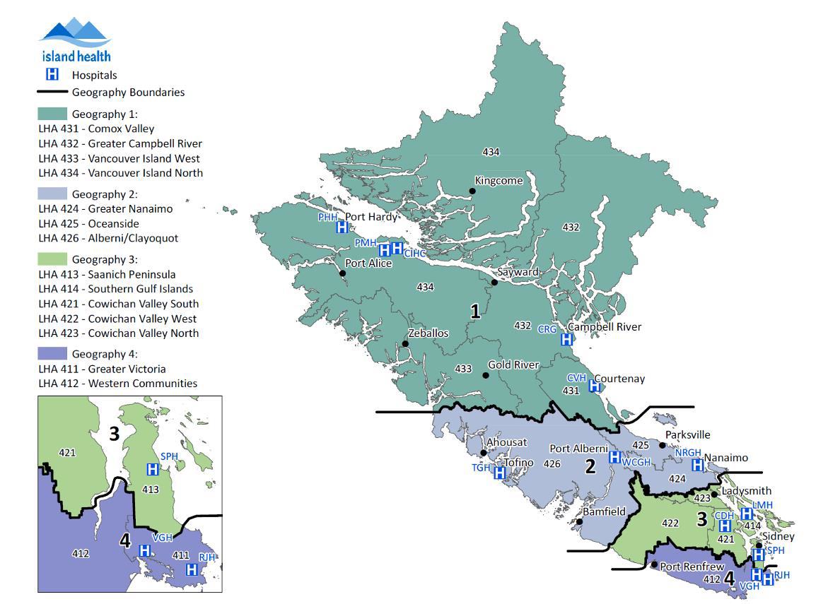
1079 providers (855 in 2021)
34 sites
2338 assignments (2240 in 2021)
310 temporary assignments with yearly performance reviews
13 division heads
One department head
A fantastic credentialing team. A fantastic recruitment team
Support from MAA closing gaps of concern, especially over the past year
About 1500 FPs on the island
353 FPs in other departments (289 in 2021)
Report to Health Authority Medical Advisory Committee April 2021
PC001

