Slide 1
Department of Primary Care
MARCH 12, 2026
Department of Family Physicians
Report to HAMAC
Dr. William Cunningham
Department Head, Family Physicians (Hospitals Act Sites)
Medical Director Primary Care
(32 Island Health Owned & Operated Primary Care Clinics)

Slide 2

Department Overview
Department of Primary Care
(Prior to restructuring and becoming the Department of Family Physicians)
SUMMARY
Providers | 1172
Assignments | 2476
 | Active | 722 | Provisional | 155 | = 877
 | Associates | 1120
 | Temporaries | 353 | (239 = PHH 38, PMH 37, TGH 93 and LMGH 56)

Slide 3
Old Structure of Department of Primary Care & New Structure Department of Family Physicians
Old (Minus Hospitalists at RJH, VGH, NRGH)
FP Rural Emergency Medicine & In-Patient MRP (PHH, PMH, CIHC, PAH, TGH, LMH)
Hospitalists/Family Physicians MRP
FP Long-Term Care
Associates
Others
New (Add Hospitalists, Hybrid Site Hospitalists, & all below)
FP Oncology
FP Obstetrics
Palliative Care & End of Life
Addiction Medicine
MAiD

Slide 4
continued
Department Overview
New added Divisions
Obstetrics, GP Oncology, GP Psychiatry
INTERESTING TO KNOW:
Entire medical staff is 3363 individuals – 48% are in the Department of Family Physicians
Standalone Divisions
Hospitalist/In-Patient MRP, Addiction, Palliative Care
1172 + 328 + 25 = 1525 (total new number of providers )
In case you’re interested, FPs do many things:
According to the Ministry of Health, 954 FPs are doing longitudinal FP in the community. This does not include Virtual care or Botox.
Also, an interesting fact – there are around 150 FPs who work in our 32 Owned and Operated Primary Care Clinics across the Island. The vast majority are part-time. There are also many NPs.
Notes:
6

Slide 5
Successes
1
We manage to do our Credentialling and Privileging successfully to keep patients safe and keep quality high. We do our Provisional to Actives and, where needed, 2-year reviews in a timely fashion. We do our temporaries quickly and performance reviews.
Charts are completed on time
There are, unfortunately, a number of Complaints, and with the support of EMSS and Dr. Bruce Campana, and sometimes our lawyer Sheila Stein, we negotiate those well in a restorative justice fashion.
2
3
Thank you to the amazing C&P team!

Slide 6
SUCCESSES continued
Successes
4
As Department Head, I get to participate at:
HAMAC, HAMAC Executive (disbanded), but still contribute with the new way.
MERC (Medical Education Resources) Committee [unfortunately on hold]
Most important ask I have is to move forwards on Cultural Safety and Humility
Looking forward to the Indigenous Health 5 point action plan being presented to DHC next week by manager Sarah Weeks
I am a voice at DHC (Department Head Council) which I have had the privilege of chairing since June 2017.
In Patient MRP focus group.
5
6

Slide 7
SUCCESSES continued
Successes
In the new CGII I get to participate in the Rural Cross Continuum Committee
Recently created Committee to look at our many associated, mostly on adjacent Island Urgent Care Centers.
I help with Projects like the eMOST and eACP (Advanced Care Planning) in CERNER EHR conversation.
Everything is helped that I co-chair the Primary Care CARE Network with Ryan Forsyth and also participate ICGC.
I get from MAA with a governance assistant. First, Jamie Copeland, and now Sarah Ciceri-Cherniwchan. It makes a difference.
7
8
9

Slide 8
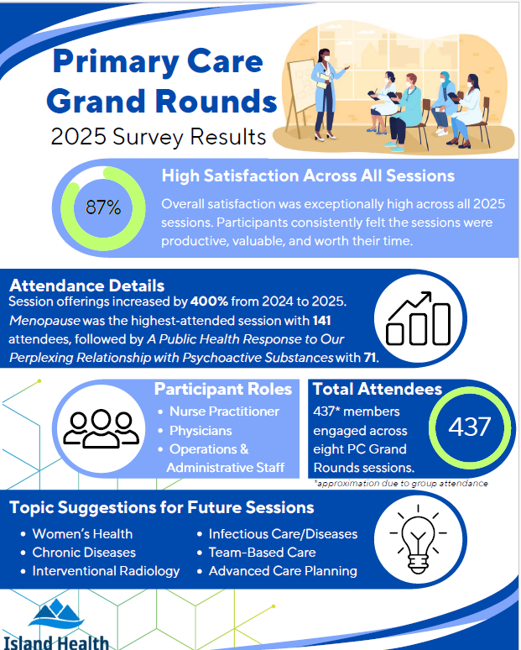
Continuing Professional Development
Grand Rounds (10 this past year!)
3 so far this year, 2 more scheduled, 1 pending
Put on collaboratively with Primary Care Strategy
Topics included, but were not limited to:
Adult Eating Disorders
Public Health & Psychoactive Substances
De-Medicalizing End of Life
Chronic Obstructive Pulmonary Disorder
Choosing Wisely: For Patients & the Planet
Using the Pathways Website to Streamline Care
Gender Diversity
Menopause
Addiction Services
Thank you to Dr. Leah MacDonald and Elizabeth Hadley!

Slide 9
Recruitment
Difficulty keeping up with demand
FPs do a huge number of different things in our HA Health Care system and community.
Numerous successes
Recruited 141 family physicians between March 3rd 2024 - March 3rd 2025
16% more than the previous year, where 122 were recruited
Recruited 37 hospitalists last year
Great help with changes of requirements from College of Physicians and Surgeons of BC, enabling further recruitment from UK, Ireland, USA, and Australia
Thank you to Harjinder Conway and Shannon Williams from Recruitment, the amazing Credentialing and Privileging team, and my go-to Jessica Havens and Michelle Powell!

Slide 10
Return of Service (ROS)
Big thank you to Christal Lawson!
20 PRA IMGs ROS in Island Health annually (96 province-wide)
ROS for those is 3 years, not including 12-week CFA required for licensure
9 CCFP ROS in Island Health
Victoria (6), Strathcona (2), Nanaimo (1)
ROS for those is 2 years
PRA-BC Retention Rate is 50% Island-wide (Stay within the HA and at their ROS clinic)
Only 4% leave their ROS clinic, but stay within the HA
UBC IMG ROS Retention Rate is 64% (Stay within Island Health at the end of their ROS period)
Only 36% stay at their ROS clinic
We are always looking for PRA assessors. Especially PRA assessors in the emerge departments and UPCCs.
Program | Higher retention rate of:
PRA-BC Program | Physician staying at their ROS clinic
UBC IMG ROS Program | Physician staying with the HA, not necessarily at their ROS clinic

Slide 11
CHALLENGES
Areas of Risk for Service Delivery
1
I cannot find Site Chiefs or Division Heads who are willing to do the job (e.g. Free standing Division of Hospitalists/In Patient MRP [8 sites NRGH/RJH/NRGH and then the hybrids SPH/CDH/CVH/CRH/WCGH].
Finding workforce to do all that we are asking FPs to do and being very aware of the contribution of Nurse Practitioners and also Midwives.
Our Hospitals Act sites use the same workforce as Community Primary Care. Currently, our Health Care system and hospitals are suffering greatly on account of the lack of Primary Care. There needs to be balance.
Rural services ED coverage. Always a challenge. We have a pool of 187 docs that do that work. Thank you Dr. Maria Kang for the help and the support staff.
Community Shift Coverage – Challenging to find coverage for family practice in the community, particularly in rural areas
2
3
4

Slide 12
Areas of Current Growth
The Department of Family Physicians has expanded significantly
From 1172 FP providers + 402 + 1574
Including changes to Credentialing & Privileging approval pathways
The key is to have standardised processes and that everyone does their work in a timely fashion.
Department – Family Physicians
FP Oncology
FP Rural Emergency Medicine & In-Patient MRP
FP Obstetrics
Associates
Standalone Divisions
Addiction Medicine
Hospitalists/Family Physicians MRP
Palliative Care & End of Life
MAiD

Slide 13
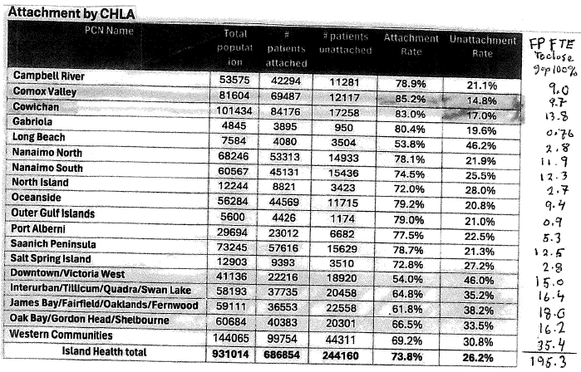
Planning for the Future
We share the workforce with community.
NOTE: The number on the Health Connect Registry is about 50% of total closure, and the number of Complex is 15%. Presumably, you want to attach those first.
However, Complex is not always those on the ACSC list. ACSC should be #1 for attachment.
To close the attachment gap, assuming 1250 patients per FP and 1000 per NP (if they work full time) – would take 195 FP (if they work full time) or 244 NP (if they work full time).
Our problem now is NOT finding FP or NP, it is finding a place for them to work.

Slide 14
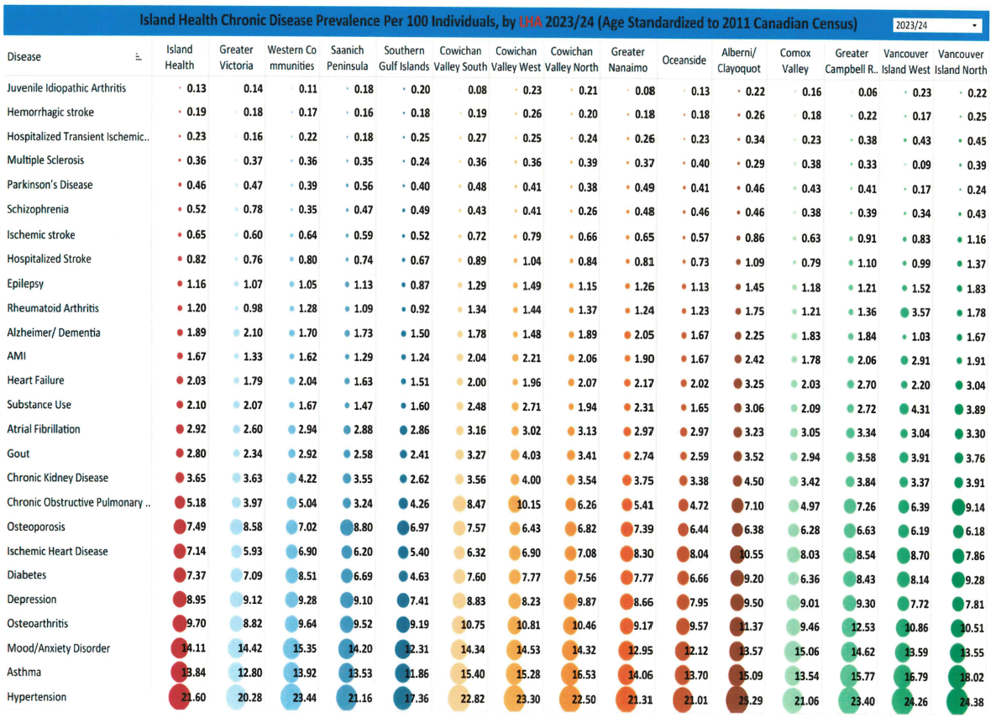
The ‘Why’
Chronic Disease Prevalence
Excellent health and care for everyone, everywhere, every time.

Slide 15
Lots of change.
The Department of Family Physicians needs to focus on Quality so that there is excellent care for everyone, everywhere, every time.
Thank you!

