Slide 1
Navigating Island Health Medical Leadership | Foundations
Notes:
[Keith]
- Today’s session is “Navigating Island Health”
Territorial acknowledgement
Intro
>me
You: Various backgrounds
ML vs Clinical
My roles
Format: 3 parts (slides online)
Goals: know who, where and when for support.
ML vs DH roles

Slide 2
Welcome to Medical Leadership
Today we will provide you with:
Overview of medical administration, structures & processes.
Answer any questions you may have about the medical leadership structure and your role.
Review organizational resource available to you.
Provide you with key contacts.
Notes:
[Keith]
- Today’s session is “Navigating Island Health”
Territorial acknowledgement
Intro
>me
You: Various backgrounds
ML vs Clinical
My roles
Format: 3 parts (slides online)
Goals: know who, where and when for support.
ML vs DH roles

Slide 3
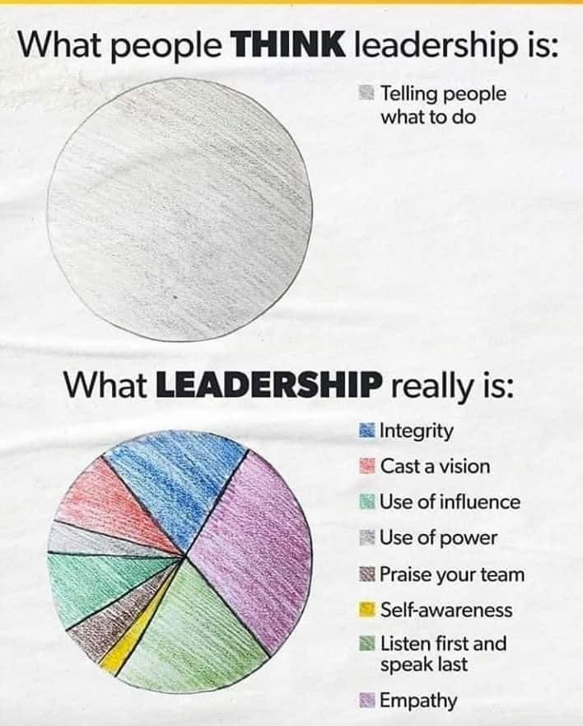
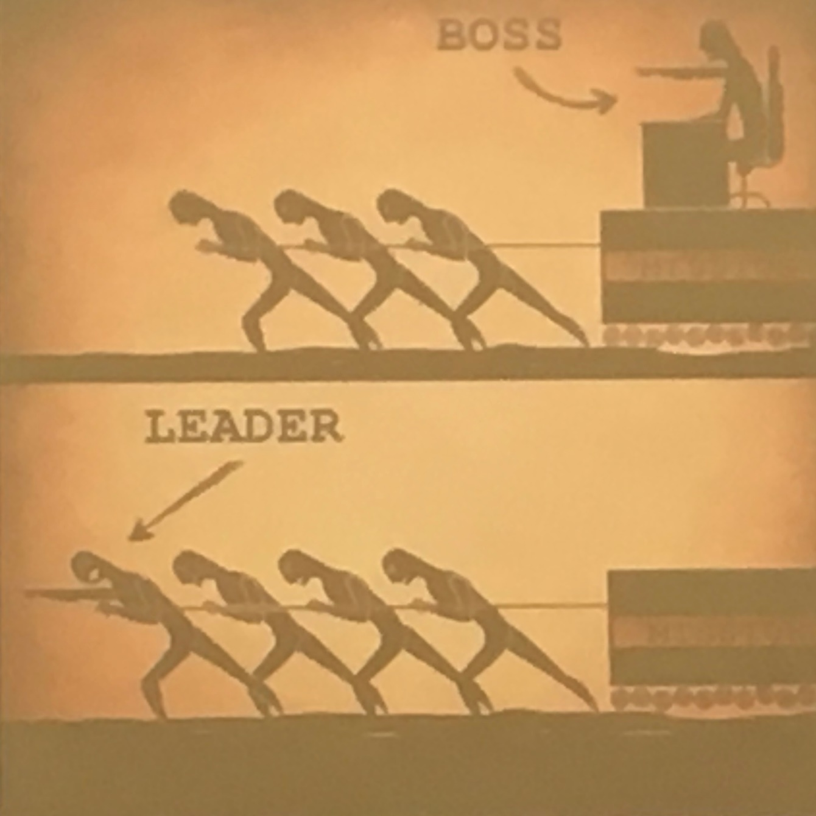

Slide 4
Welcome to Medical Leadership
Today is only part of medical leadership orientation:
Online internet resources (including these slides) on the Medical Staff website
Todays session “Navigating Island Health Medical Leadership: Foundations”: overview of who and where.
Additional sessions in the “Navigating Island Health Medical Leadership Series”:
Credentialing and Privileging
EMSS and medical staff behavior challenges
Contracts and Workforce planning
Quality structures
Working in medical leadership dyads

Slide 5
Welcome to Medical Leadership Series
Enhanced Medical Staff Support
Speaker: Dr. Bruce Campana, Medical Director
Contracts and Compensation
Speaker: Dr. Dean Kolodzijczyk Medical Director
Credentialing and Privileging
Facilitator: Jill Pearman, RM, Medical Director
Human Resource Planning
Facilitator: Dr. Keith Menard, Medical Director
Patient Safety and Quality
Facilitator: Dr: Daisy Dulay
Notes:
Medical leaders primary person. Manager a back-up.

Slide 6
Island Health Executive Team

Slide 7
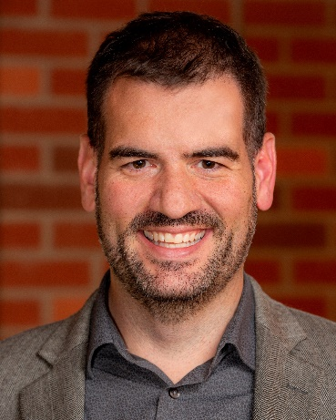
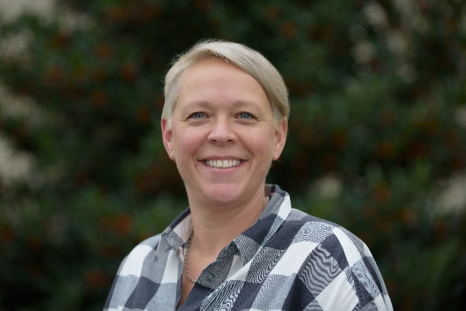
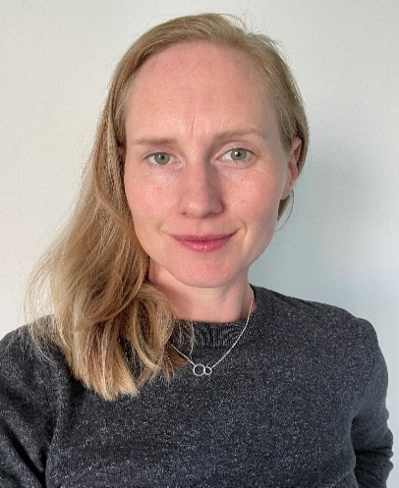
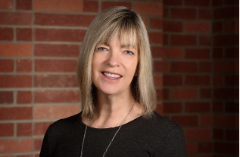
Medicine VP/Executive Team
Dr. Ben Williams VP Medicine, Quality, Research and Academic Affairs and Chief Medical Executive
Dr. Michelle Weizel
Associate Vice President, Medicine and Deputy Chief Medical Officer
Dr. Chris Hall Associate Vice President, Quality and Safety
Sarah Taylor
Director, Office of the VP of Medicine, Quality, Research and Academic Affairs

Slide 8
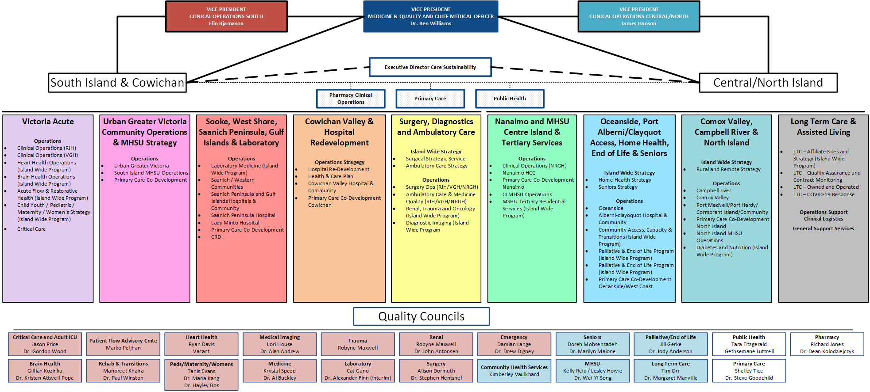
Island Health Clinical Structure
Notes:
[Keith]
Operations and Sites in bundles
SI and NI;
not Geos as much.
All services (not MS alone)

Slide 9
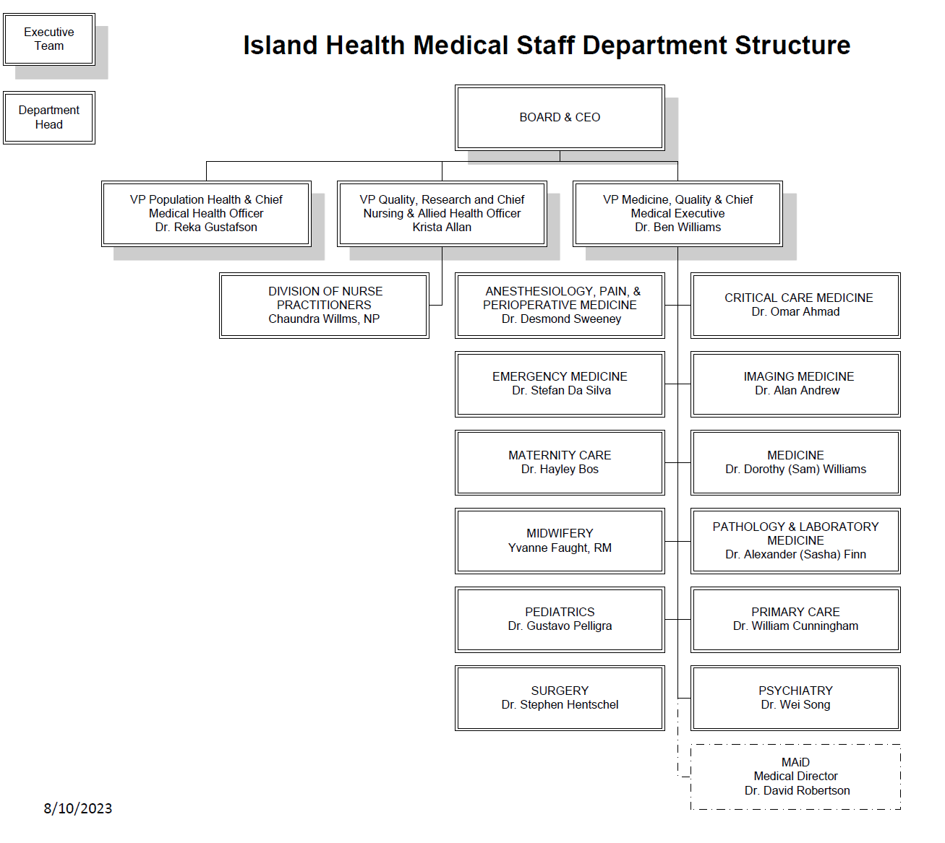
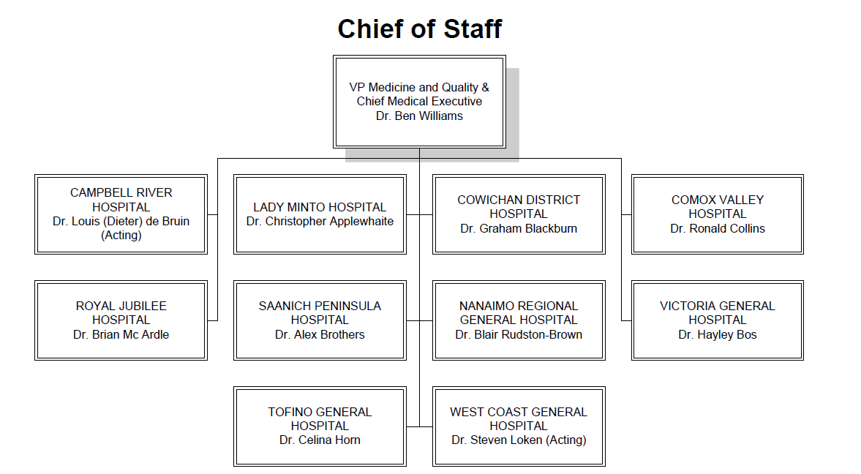
Medical Staff: Governance Leadership
Notes:
[Keith]
Explain sides and COS roles as overlap.

Slide 10
Roles and Responsibilities
Notes:
[Keith]
Explain sides and COS roles as overlap.

Slide 11
Medical and Academic Affairs: for medical staff
Notes:
[Keith]
The committees and “vehicles” for the work of MAA
Where input is collected from MS and decisions are made

Slide 12
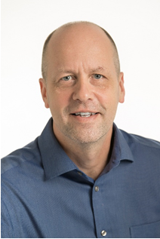
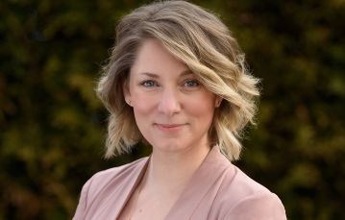
Medical and Academic Affairs (MAA) Executive Team
Dr. Keith Menard Executive Medical Director,
Medical Staff Governance
Laura Nielsen Executive Director,
Medical & Academic Affairs
Dr. Michelle Weizel Executive Medical Director, Medical and Academic Affairs

Slide 13
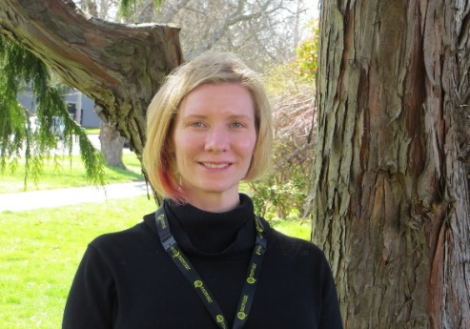
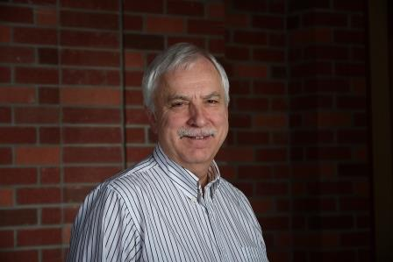
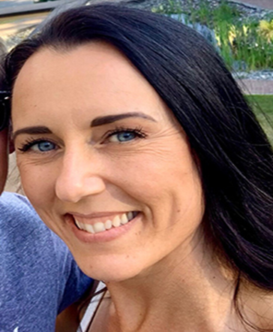
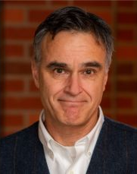
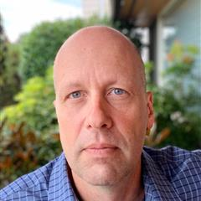
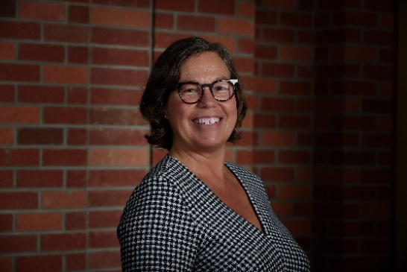
Medical Affairs (MAA) Leadership
Emma Isaac Director, Primary Care Support & Resources
Dr. George Forster
Medical Director, Primary Care
Support and Resources
Jill Pearman, RM
Medical Director, Medical Staff Credentialing, Privileging and Governance
Dr. Bruce Campana
Medical Director, Enhanced Medical Staff Support
Dr. Keith Menard Medical Director,
Human Resources Planning
Sara Campbell Director, Medical Staff Support and Resources

Slide 14
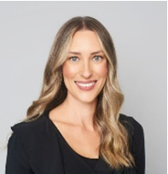
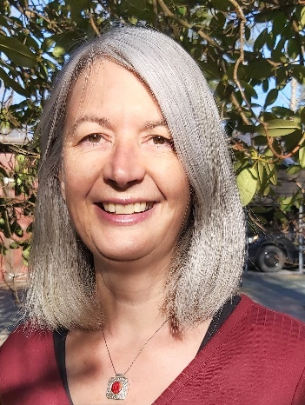
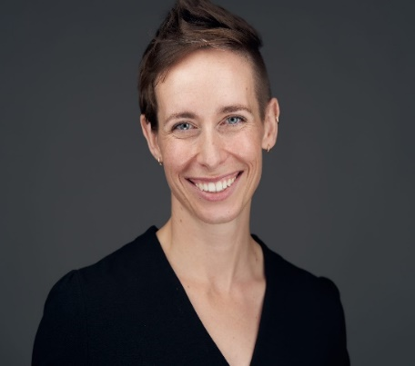
Medical Affairs (MAA) Leadership
Ms. Alanna Black
Director, Medical Staff Partnerships and Communications
Ms. Jennie Aitken
Director, Medical Staff Quality and Improvement
Dr. Adele Harrison
Medical Director, Clinical Improvement & Medical Staff Development

Slide 15
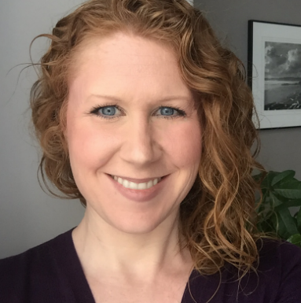
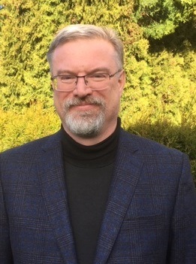
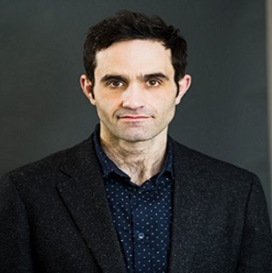
Medical Affairs Leadership
Christine Jeffrey Director, Practice Design & Compensation
Dr. Dean Kolodziejczyk
Medical Director, Medical Staff Contract and Compensation
Geoffrey Homer Director, Clinical Service Contract Negotiation

Slide 16
MAA: Medical Staff Governance Structures
Notes:
[Keith]
The committees and “vehicles” for the work of MAA
Where input is collected from MS and decisions are made

Slide 17
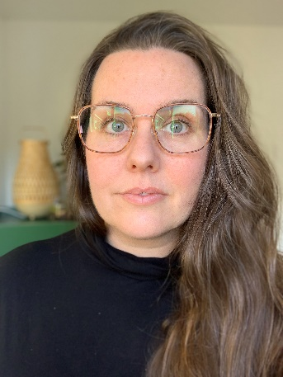
Jill Pearman RM
Medical Director, Medical Staff Credentialing, Privileging and Governance
Leslie Rewega
Manager, Medical Staff
HR Planning and Governance
Notes:
[Keith]
Supports departmental- recall the chart in the beginning that outlines the departmental and operational structures. This team supports the left side of the table – the departmental structure
Support implementation of the Medical staff Bylaws and rules
Developing better reporting up and down
Update with committee slide. Connectivity

Slide 18
HAMAC (Health Authority Medical Advisory Committee)
Diverse membership: Dept Heads, Chiefs of Staff, MSA and Executive Medical Directors.
Endorses the work and recommendations of subcommittees
Makes recommendations directly to the Board Of Directors
Focus is the quality, effectiveness, and availability of medical care provided within VIHA Facilities and Programs
Advises operational teams, but does not advise Board on operational issues.

Slide 19
Medical Staff Committees:
Local Medical Advisory Committees (LMACs):
Campbell River District Hospital | Dr. Louis de Bruin (Acting)
Chemainus Health Care Centre | Dr. Tanis Morris
Comox Valley Hospital | Dr. Ron Collins
Cowichan District Hospital | Dr. Graham Blackburn
Lady Minto Hospital | Dr. Christopher Applewhaite (interim)
Ladysmith Community Health Centre | Dr. Matthew Toom
Nanaimo Regional General Hospital | Dr. Blair Rudston-Brown
Saanich Peninsula Hospital | Dr. Alex Brothers
South Island LMAC (VGH, RJH) | Dr. Hayley Bos & Brian Mc Ardle
Tofino General Hospital | Dr. Celina Horne
West Coast General Hospital | Dr. Steven Loken (Acting)
HAMAC (Health Authority Medical Advisory Committee) | Dr. David Butcher
HAMQC (Health Authority Medical Quality Committee) | Dr. Chris Hall
MPCC (Medical Planning and Credentials Committee) | Jill Pearman RM
MERC (Medical Education Resources Committee) | Dr. Keith Menard
LC (Legislative Committee) | Chaundra Willms NP
Notes:
Keith]
/briefly the committees and Chairs
LMACS: hospitals plus 2 (Ladysmith and chemainus). future others?
LMACS design to align with HAMAC (medical staff quality and care)

Slide 20
Medical Staff Associations (MSAs)
MSAs consist of medical staff who have privileges at 11 sites
To provide voice to the Medical Staff and to represent the views of its local
To provide a forum to inform and connect the Medical Staff
To raise regional matters of significance with local administration and HAMAC
To engage members on program and resource planning
Report to HAMAC through HAMSA
For more information visit
https://medicalstaff.islandhealth.ca/index.php/medical-staff-associations

Slide 21
Credentialing & Privileging
Credentialing is the process whereby a Practitioner’s qualifications (education, training, experience and professional attributes) are validated and reviewed against established standards
Privileging is the process whereby a Practitioner is authorized to practice within a particular clinical domain and provide particular clinical procedures at a specific site (or sites).
Notes:
Explain difference
A site can do this, not that

Slide 22
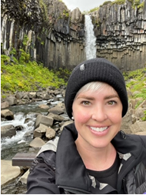
Credentialing & Privileging
The main functions of the Medical Staff Credentialing & Privileging team are to support with inquiries, including but not limited to:
Specifics regarding individual medical staff credentialing & privileges in your department
Reports/directory (CACTUS) for Medical Staff within your department
Provider Reappointment
Category Changes, leaves of absence, site changes & Locum Tenens
Jill Pearman RM
Medical Director, Medical Staff Credentialing, Privileging and Governance
For more information visit https://medicalstaff.islandhealth.ca/organization/medical-academic-affairs/credentialing-and-privileging
Jessica Havens
Manager, Medical Staff Credentialing and Privileging
Notes:
Categories: understand (DH/SH), as well as LOA

Slide 23
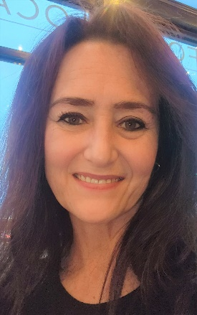
Enhanced Medical Staff Support (EMSS)
The main functions of the Enhanced Medical Staff Support (EMSS) team are to:
Supports medical leaders who may be asked to attend to concerns raised regarding professionalism or performance of medical staff
Supports & helps to resolve professional issues as they arise, & works proactively to enhance the capacity & ability of medical & other leaders across the organization to understand, manage & resolve concerns
Supportive, solutions-based rather than punitive if possible
Dr. Bruce Campana
Medical Director, Enhanced Medical Staff
Daphne Van der Boom
HR Specialist, Enhanced Medical Staff
For more information visit
https://medicalstaff.islandhealth.ca/organization/medical-academic-affairs/enhanced-medical-staff-support-emss
or contact Bruce.Campana@islandhealth.ca
Notes:
Support service available when issues arise around professionalism involving members of medical staff
Respectful workplace redirects
Supportive approach, non- punitive where possible
Contact for early guidance, advise,
Do not consider this as a ‘reporting’ process
-Tool kit with stages
MS concerns: DH or SH >>> DH or COS.

Slide 24
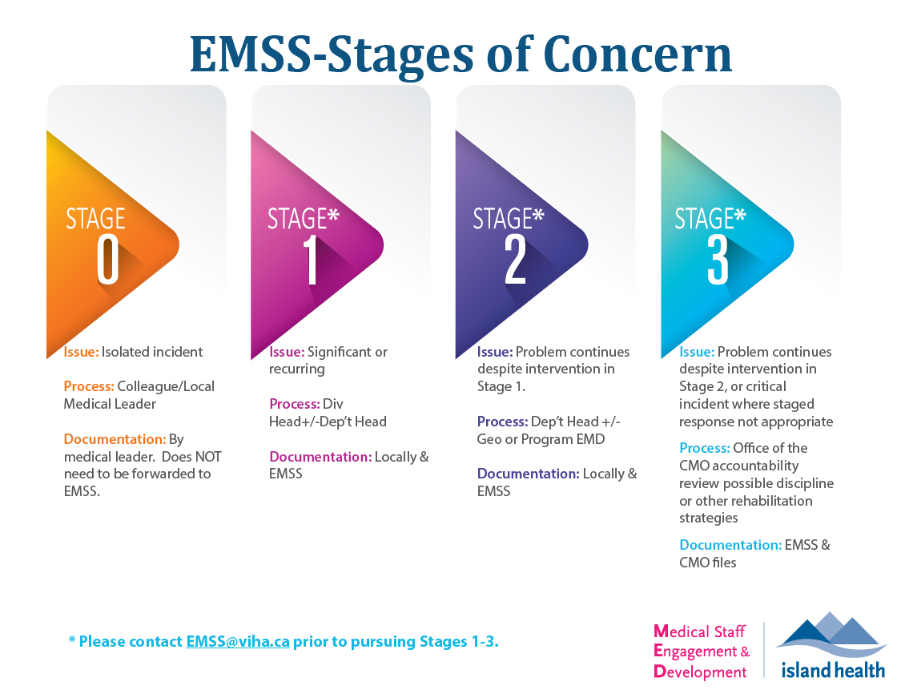
No
Notes:
Here is graphic explaining the stages of support and discipline. Just remember that 0 is better than 3. There are a fair number of 0s. Very few 2s and 3s.

Slide 25
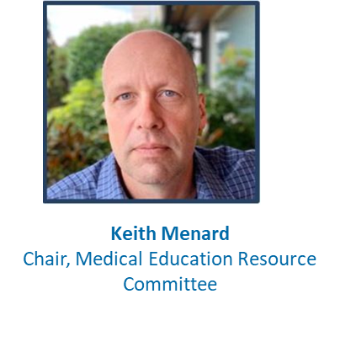
Partnerships, Communication & Leadership Development
Medical staff communications including medical staff website (https://medicalstaff.islandhealth.ca), newsletters & bulletins, events calendar, town halls
Develop & support systems navigation through orientation for medical leaders & medical staff; additional supports available for rural physicians.
Support departmental CPD rounds and other organizational education.
Advises on CME accreditation process.
Develops leadership development programing
Promotes learning opportunities
Administration of education funding
For more information visit https://medicalstaff.islandhealth.ca/organization/medical-academic-affairs/communications-and-development
Contact: MedStaffCommunications@islandhealth.ca or MedStaffDevelopment@islandhealth.ca
Notes:
Communication key thru covid
Developed robust newsletter and town hall, lots of engagement
Opportunities: news, members events, etc

Slide 26
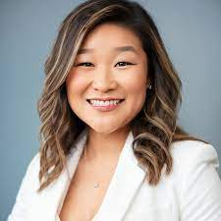
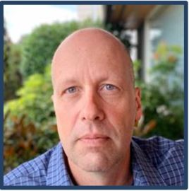
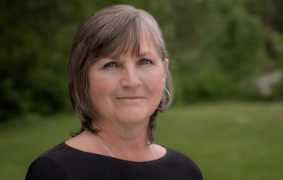
Recruitment
Human Resource Planning
Assist departments with impact assessment & approval process for recruitment of physicians, midwives and dentists
Provide advice & support to ensure compliance with the recruitment policy
Support search & selection processes
Manage the Practice Ready Assessment & UBC IMG Return of Service programs
Maria Kang
Medical Director, Recruitment and Service Stabilization
Keith Menard
Medical Director, Medical Staff Human Resources Planning
For more information visit
https://medicalstaff.islandhealth.ca/organization/medical-academic-affairs/recruitment
or contact Eva.Vincent@islandhealth.ca
Eva Vincent
Manager,
Medical Staff Recruitment
Notes:
Keith] –
Ensuring fair recruitment practice
Necessary approvals
Supporting selection committee
Position inventory database, how many medical staff, and FTE ish assignment
IMG – ensure physician requirements are completed
Spec Recruitment POLICY: KNOW!

Slide 27
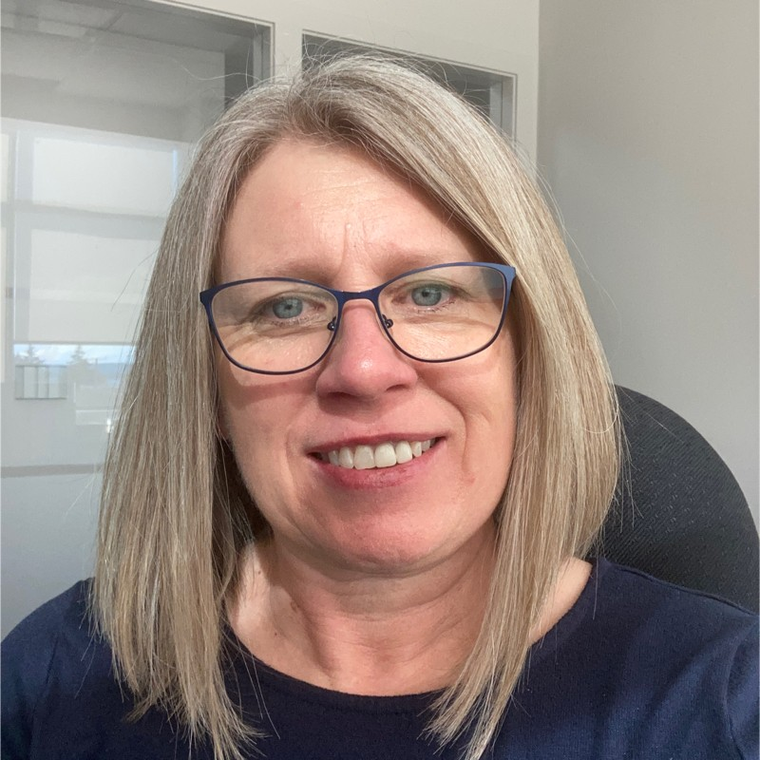
Practice Design Support and Compensation
Provide guidance on designing, developing and describing medical staff services at Island Health.
Work in partnership with departments to find contract solutions for medical staff
Christine Jeffrey Director, Practice Design & Compensation
Laura Swanstrom Manager, Medical Staff Compensation and Practice Design
For more information visit https://medicalstaff.islandhealth.ca/organization/medical-academic-affairs/practice-design-support
or contact laura.swanstrom@islandhealth.ca

Slide 28
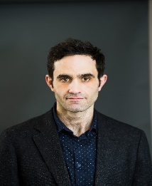
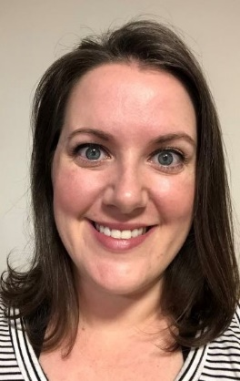
Contract Management
Negotiate and prepare medical staff contracts for clinical, on-call (MOCAP), medical leadership and physician administrative services;
Process medical staff payments;
Facilitate medical staff contract management;
Provide stewardship for Ministry funds that support these services.
Dr. Dean Kolodziejczyk
Medical Director, Medical Staff Contract and Compensation
Jessie Mathie Manager, Medical Staff Contract Management
For more information visit https://medicalstaff.islandhealth.ca/organization/medical-academic-affairs/contract-management
or contact Jessie.Mathie@islandhealth.ca
Notes:
Geoff new
APP, MOCAP

Slide 29
Medical Staff Quality Structures and Services
Notes:
[Keith]
40 mins

Slide 30
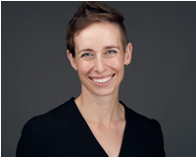
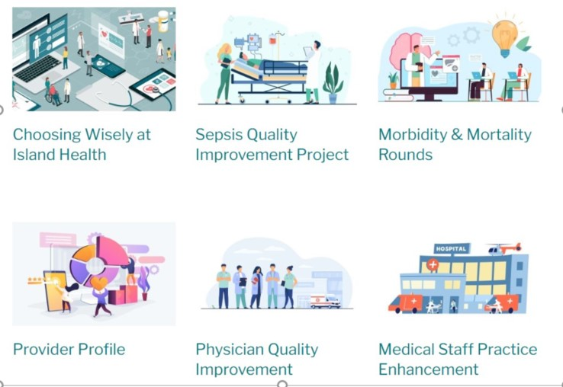
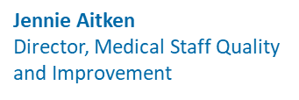
Medical Staff Quality
Dr. Adele Harrison
Medical Director, Clinical Improvement &
Medical Staff Development
For more information about Medical Quality visit https://medicalstaff.islandhealth.ca/working-change/medical-quality
Or contact MedStaffQI@islandhealth.ca
Notes:
MS specifically:
MAA teams above
Many projects/teams for MS focused QI

Slide 31
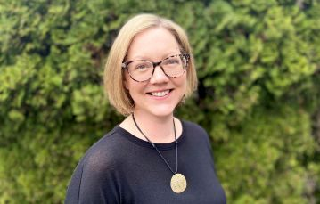
Physician Quality Improvement
A professional development program available to a limited number of Island Health medical staff each year.
Program supports participants to catalyze improvements in care quality by providing education, mentorship and technical support over 12 months.
In addition, regular opportunities for medical staff to network & learn about quality improvement
Unfortunately only for physicians.
Dr. Adele Harrison
Medical Director, Clinical Improvement &
Medical Staff Development
Karen Phenix
Manager, PQI/SQI
For more information visit
https://medicalstaff.islandhealth.ca/physician-quality-improvement
or contact Karen Phenix Manager, PQI/SQI Karen.phenix@islandhealth.ca
Notes:
Currently enrolling my cohort. Not filled!
Best entry for new leaders.
For new graduates wanting to continue clinical research.

Slide 32
Island Health Quality Structures and Services
Notes:
[Keith]
40 mins

Slide 33
CGII (Clinical Governance Initiative)
The Clinical Governance Improvement Initiative (CGII) was launched in the fall of 2021.
Improving clinical governance improves clinical outcomes for patients, families and care teams.
4 major lenses:
leadership & culture;
continuous improvement;
people-centred;
shared decision-making & accountability.

Slide 34
The Clinical Governance Improvement Initiative (CGII) was launched in the fall of 2021. Improving clinical governance improves clinical outcomes for patients, families and care teams. We have been listening to our care teams, and we are proud to be taking meaningful steps towards clear, simple, and transparent clinical governance and accountability. According to the Health Standards Organization, clinical governance is the framework by which the governing body, leaders, and health care providers have responsibility and accountability for the quality of care. The CGII is a critical next step in strengthening our​ organizational foundation for culturally-safe high-quality care, and for helping us achieve our strategic framework goals​ by 2025.
Clinical Governance Improvement Initiative | Medical Staff (islandhealth.ca)
Notes:
Roles are different
Programs: standards, best practice
Geos: implementation
Intersect w/ Medical Leads
Example: Pediatric Asthma

Slide 37
CARE Committees:
Goal: 4 medical staff for each Clinical Excellence Committee, 2 for each Operations Excellence Committee.
Each committee will have approximately 20 members, not including chairs and patient partners.
Remaining membership will include representatives from local quality and operations committees and professions that represent the scope of practice in the service.
Each OEC and CEC will have different members.
C.A.R.E. Network committees began functioning in September 2023.
Clinical Governance Improvement Initiative | Medical Staff (islandhealth.ca)

Slide 38
Patient Care Quality Office (PCQO) Patient Safety Learning System (PSLS)
PCQO purpose within Island Health is to provide an accessible, visible and transparent point of contact for patients, family members and /or their representatives to share feedback, compliments, obtain clarification and information, and to resolve concerns about quality of care received.
https://intranet.islandhealth.ca/departments/quality/pcqo/Documents/director-tool-kit.pdf
The BC Patient Safety & Learning System is a web-based reporting tool that helps health-care providers manage patient safety events and share lessons learned to improved patients’ safety and quality of care.
https://intranet.islandhealth.ca/departments/quality/psls/Pages/default.aspx
Notes:
Send to Director, can we confirm this content is correct? Cc’d to Daisy HM -

Slide 39
IHealth Governance Medical Leadership
IHealth Program Oversight
Ministry of Health, Board, and Executive oversight for IHealth progress, financials, and risks through the IHealth Task Force, IHealth Clinical Executive Steering Committee, and IHealth Financial Oversight Committee.
IHealth-specific forums that oversee the design of EHR workflows and the EHR system configuration.
Medical Staff regional council that meets monthly for Medical Staff Association (MSA) and Health authority engagement.
For more information visit: https://ihealth.islandhealth.ca/
IHealth Leadership
https://ihealth.islandhealth.ca/ihealth-for-staff/for-medical-staff/ihealth-medical-specialty-leads/
Notes:
KV to provide insight.
Third bulletin Health authority medical staff enagement. MSA?
Medical Staff regional council that meets monthly for Medical Staff Association (MSA) and Health authority engagement.

Slide 40
Working for Change
Notes:
[Keith]
The committees and “vehicles” for the work of MAA
Where input is collected from MS and decisions are made

Slide 41
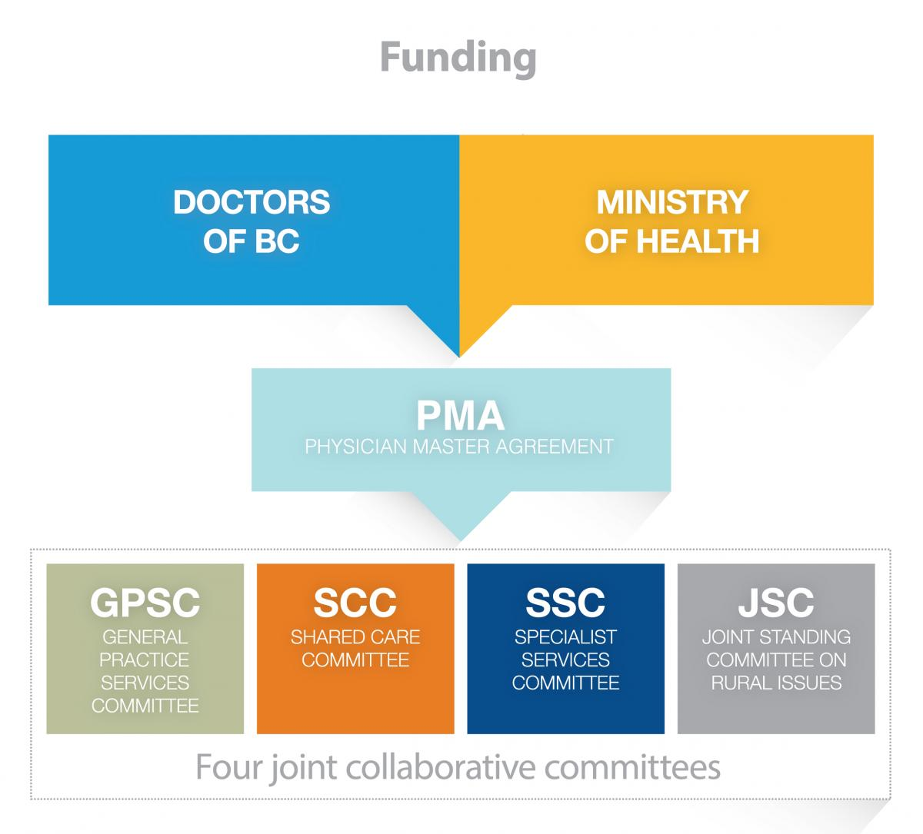
External funding for medical staff Physicians!
For more information visit
https://medicalstaff.islandhealth.ca/working-change/external-resources
Notes:
[Keith]
DOBC and MOH fund primary MS engagement money (non-leaders)
Problem: NP and MW
PQI: members directly to team (annual cohort recruitment)
FEI: MSA managed (rolling process?)
HSR: MAA managed (annual requests for project)

Slide 42
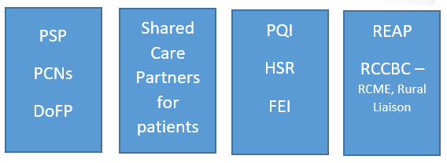
External funding for medical staff Physicians!
For more information visit
https://medicalstaff.islandhealth.ca/working-change/external-resources
Notes:
PQI: members directly to team (annual cohort recruitment)
FEI: MSA managed (rolling process?)
HSR: MAA managed (annual requests for project)

Slide 43
Island Health Strategic Planning

Slide 44
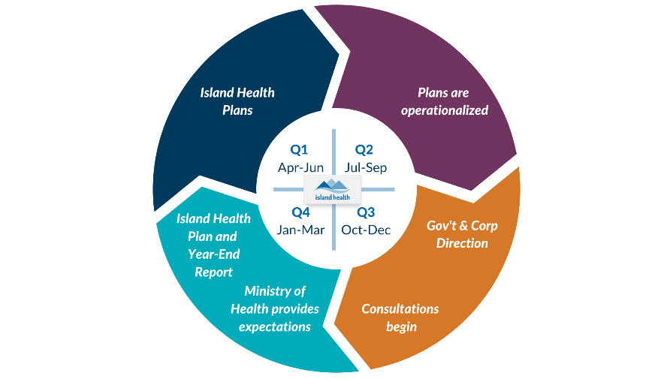
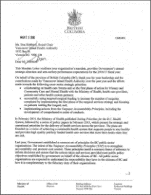
Direction Setting – Strategic Alignment
Government Strategy
Ministry Strategy
Bilateral meetings with CEO, Board Chairs, Deputy Minister
Health Authority Mandate letter
Island Health Strategic Work Plan Priorities | Reflects Priorities related to COVID-19 and Ministry Mandate Letter
Island Health strategic planning
Island Health Strategic Plan
https://connect.viha.ca/strategic-framework
Notes:
Update!
Direction setting documentation:
- Ministry of Health Strategic plan
- Government strategic plan
- Bilateral meeting with CEO
- Government mandate
- Island Health Strategic Priorities

Slide 45
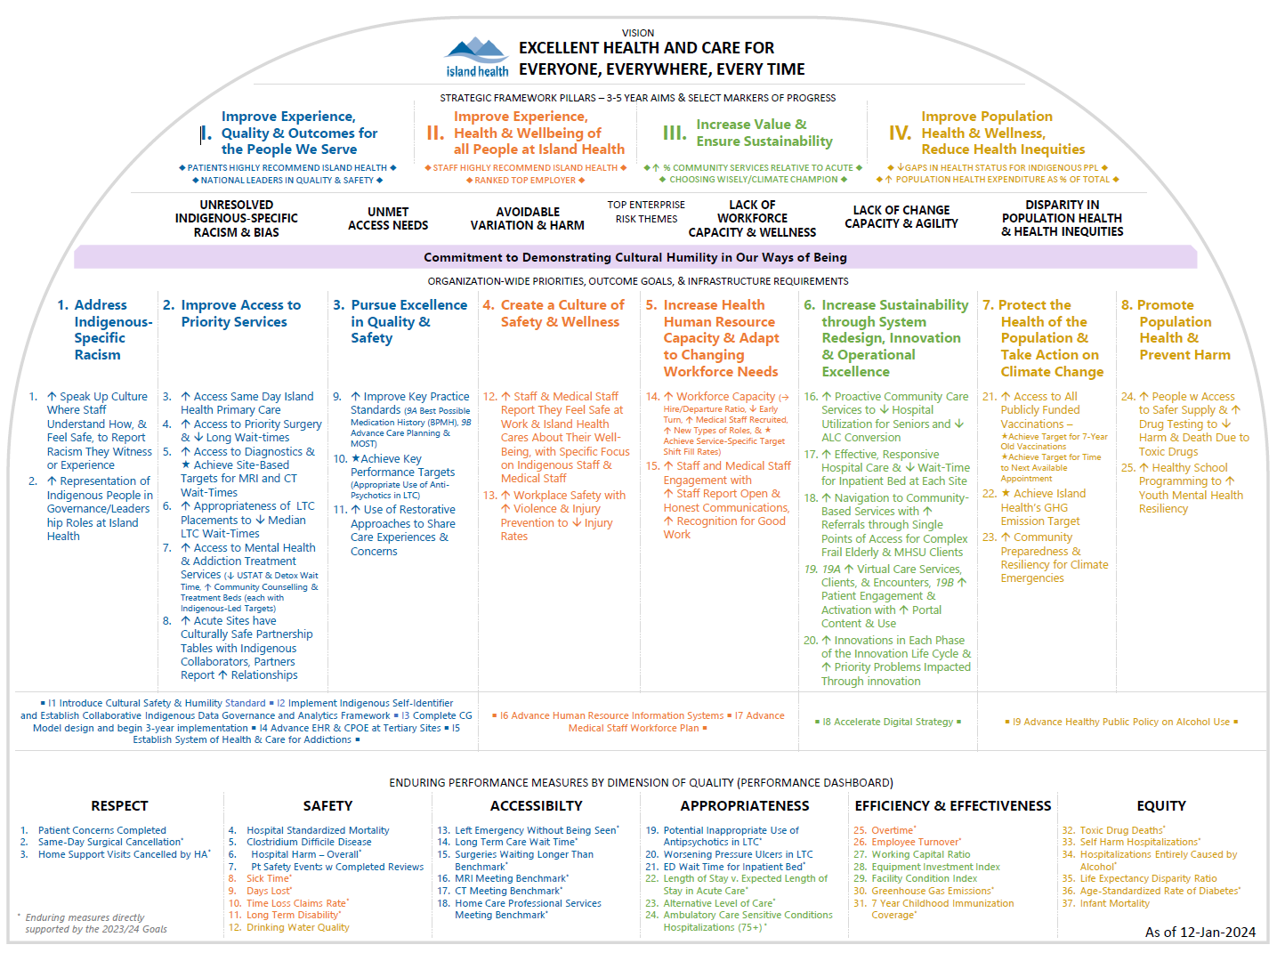

Slide 46
Thank You for stepping up!
Notes:
[Keith]
40 mins

Slide 47
Hello Everyone, The Physician Quality Improvement (PQI) team at Island Health is hosting an event on October 6th 9:00am-4:00pm at the Four Points by Sheraton in Victoria to connect physicians interested in QI with clinical structures to enhance healthcare improvement efforts and to develop meaningful physician involvement in system-level change. We would love you to attend if you can! If you are only able join for half the day, your attendance in the morning would be fantastic. Compensation will be provided to physicians, as well as applicable travel and accommodation expenses for those travelling from outside of Victoria. Please let us know as soon as possible if you can attend: https://surveys.viha.ca/surveys/quali-con More event details below and attached. We hope we will see you there! Have a wonderful day, Julia
When: | Friday, October 6th from 9:00am-4:00pm
Where: | Four Points by Sheraton, 829 McCallum Road, Victoria
How do I sign up? | Please register as soon as possible: https://surveys.viha.ca/surveys/quali-con
How to get in touch: | If you have any questions, please reach out to PQI@islandhealth.ca
Celebrate excellent Physician-Driven QI work done in the Island Health region over the last 7 years. |  |  | Connect with peers and clinical structures from across the island. |  |  |  | Contribute to shaping the future of QI in our region.

Slide 48
Thank You For Your Leadership
Ongoing System Navigation
Contact
Medical Staff Communications, Education & Development
MedStaffDevelopment@islandhealth.ca
Notes:
[Jennifer]
Contact us
Slides available on website
Send survey
Continuing to enhance materials so please use this as a hub for your information needs
And please reach out at any point – as mentioned earlier we are a contact for you thorough your tenure

Slide 49
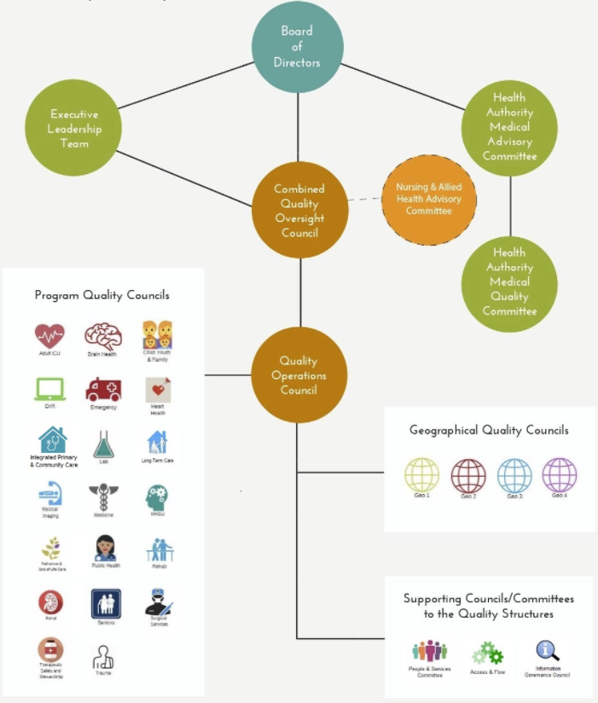
Island Health’s Quality Structure
The Quality Structures are the “information highway for quality”, where structures and process are in place to enable:
High Standards of care
Transparent accountability for those standards
A constant dynamic of improvement
For more information visit
https://medicalstaff.islandhealth.ca/quality-safety-and-improvement-quality-structure
Notes:
Overarching QC
Programs and Geos (intersect)
…HAMQC make mention – how it aligns

Slide 50
Island Health’s Quality Structure
The Quality Structures are the “information highway for quality”, where structures and process are in place to enable:
High Standards of care
Transparent accountability for those standards
A constant dynamic of improvement
CURRENT: ENDING!
For more information visit
https://medicalstaff.islandhealth.ca/quality-safety-and-improvement-quality-structure
Notes:
Overarching QC
Programs and Geos (intersect)
…HAMQC make mention – how it aligns

Slide 51
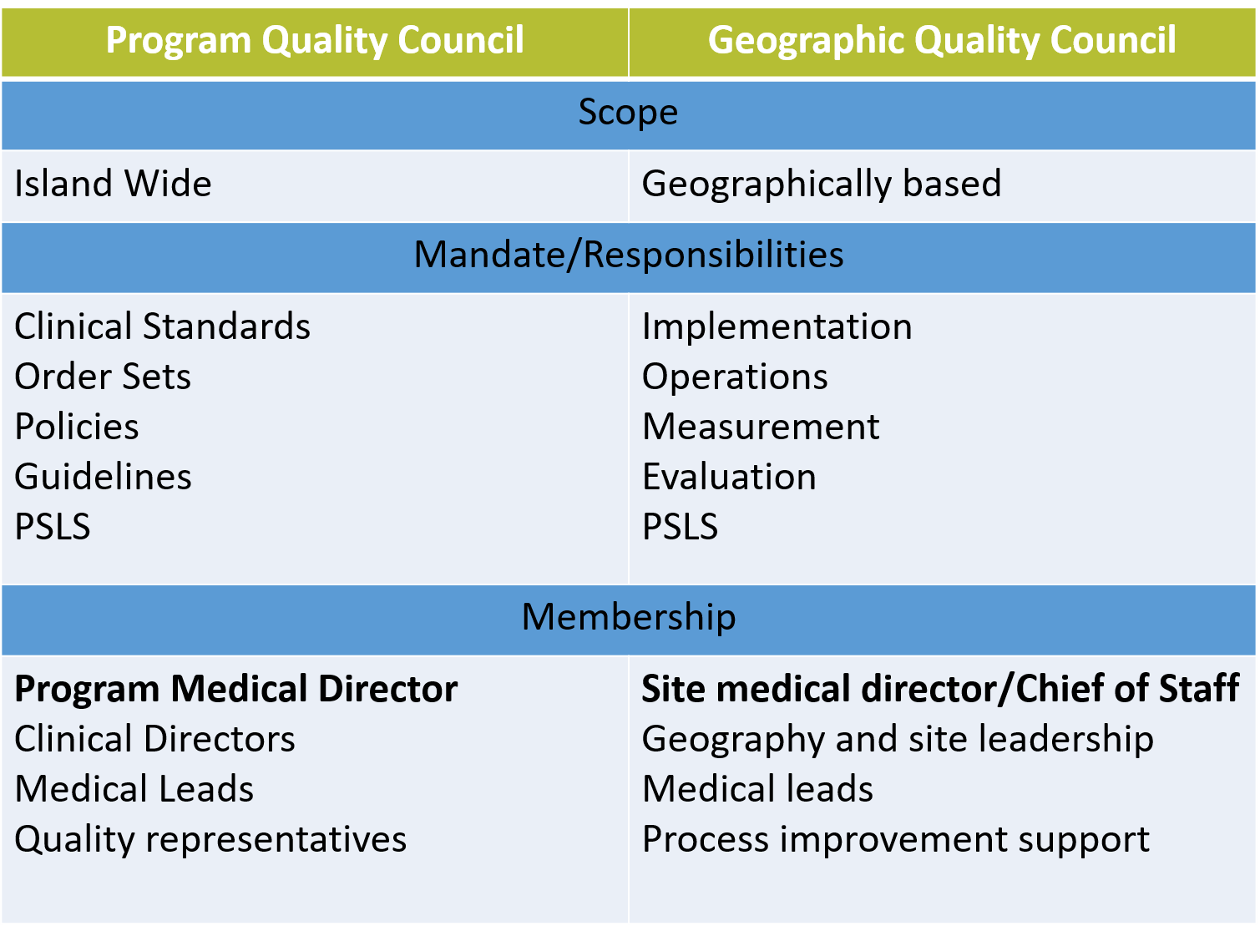
CURRENT: ENDING!
Notes:
Roles are different
Programs: standards, best practice
Geos: implementation
Intersect w/ Medical Leads
Example: Pediatric Asthma

