Slide 1



Navigating Island health Medical Leadership
ONboarding FOUNDATIONS
Notes:
[Keith]
- Today’s session is “Navigating Island Health”
Territorial acknowledgement
Intro
>me
You: Various backgrounds
ML vs Clinical
My roles
Format: 3 parts (slides online)
Goals: know who, where and when for support.
ML vs DH roles

Slide 2

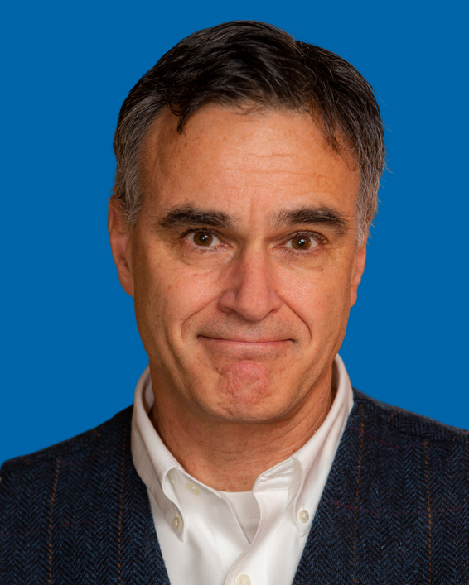
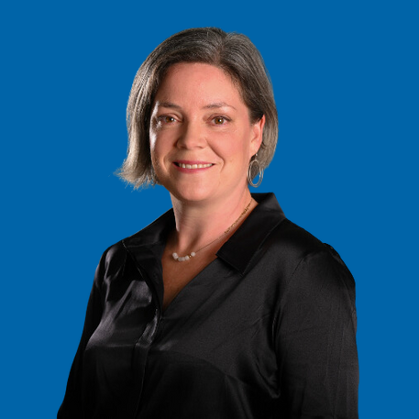
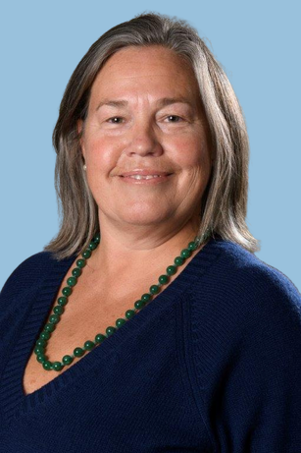
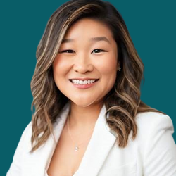
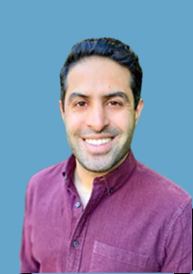
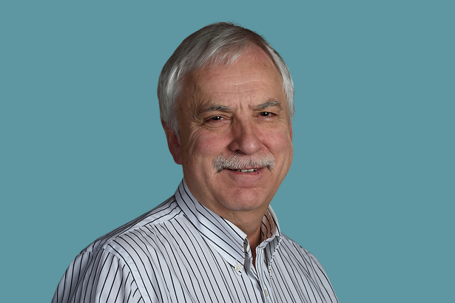
Navigating Island Health
Medical Leadership Series
Onboarding Foundations
Dr. Sarah Lea,
Education, Onboarding & Leadership Development
Enhanced Medical Staff Support (EMSS)
Dr. Bruce Campana,
Medical Director
Contracts &
Compensation
Alicia Power,
Medical Director
Credentialing,
Privileging & Governance
Jill Pearman, RM,
Medical Director
Recruitment &
Stabilization
Dr. Maria Kang,
Medical Director
Patient Safety
& Quality
Dr. Ali Yakhshi Tafti
Medical Director
Primary Care Strategy and Resources
Dr. George Forster
Medical Director
Notes:
Medical leaders primary person. Manager a back-up.

Slide 3
Today’s Agenda
  Introduction to Island Health
  Overview of medical administration, structures & processes
  Leadership structure Q & A
  Review organizational resources
  Foundations handbook
Notes:
[Keith]
- Today’s session is “Navigating Island Health”
Territorial acknowledgement
Intro
>me
You: Various backgrounds
ML vs Clinical
My roles
Format: 3 parts (slides online)
Goals: know who, where and when for support.
ML vs DH roles

Slide 4

GOVERNANCE

Slide 5
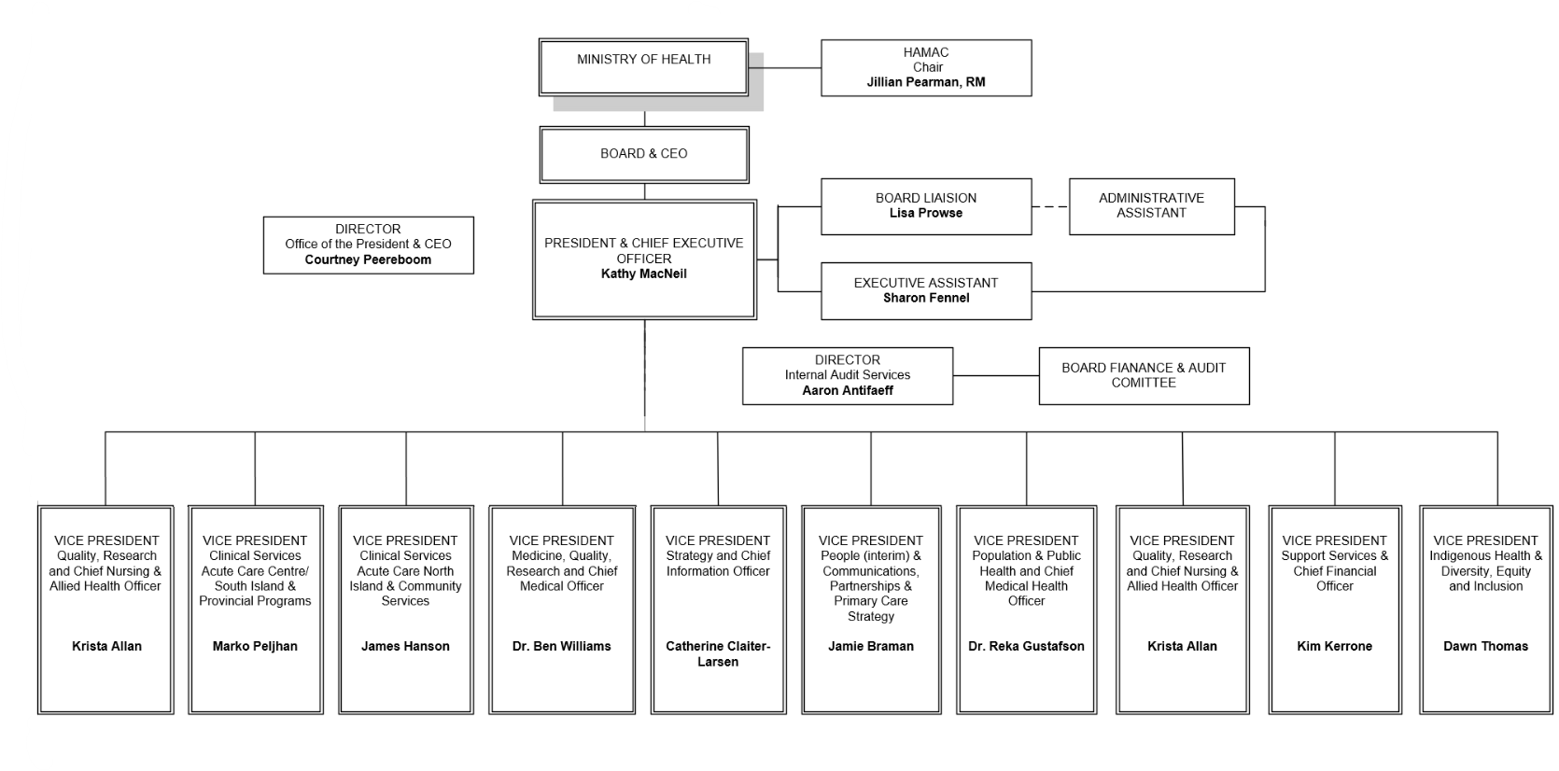
Island Health
Executive Leadership

Slide 6
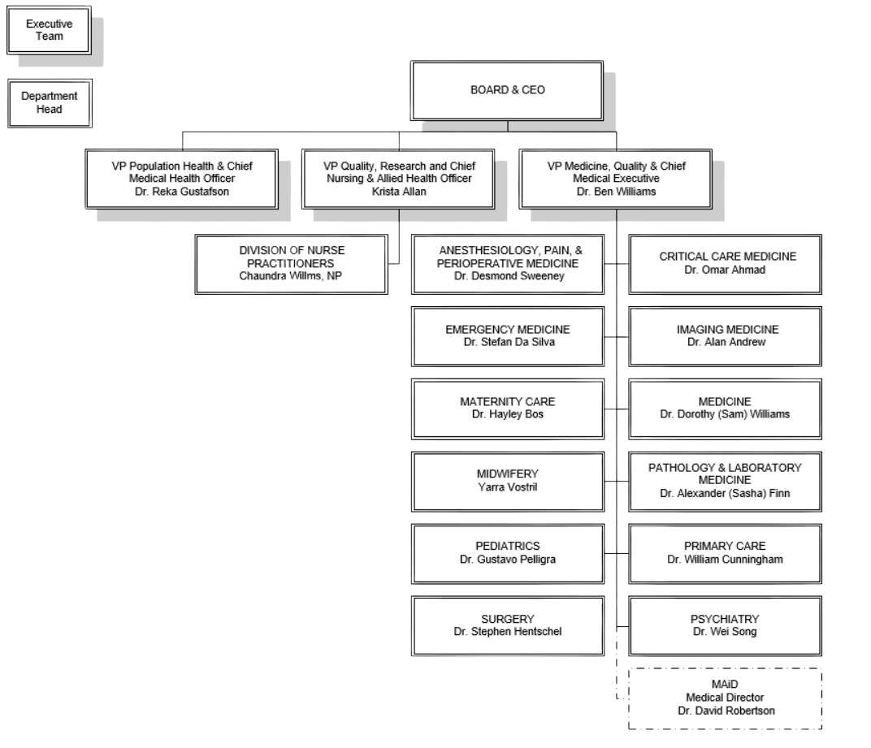
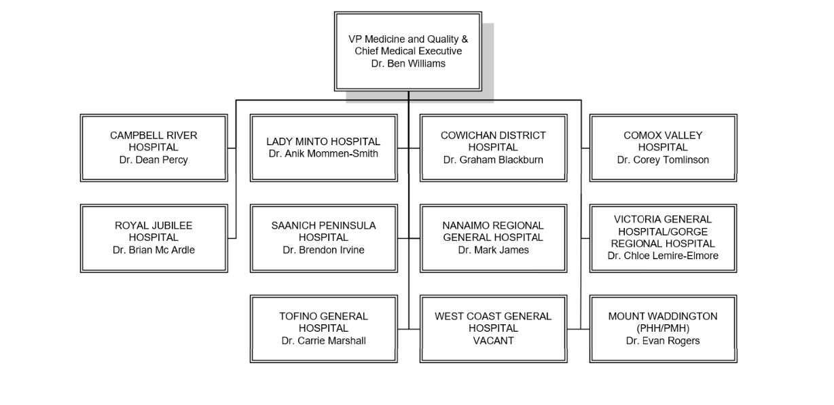
Medical Staff Leadership
Island Health Medical Staff Department Structure
Chief of Staff
Notes:
[Keith]
Explain sides and COS roles as overlap.

Slide 7
Roles & Responsibilities
Position | Role | Focus | Example Function | Accountability
DEPARTMENTAL LEADERSHIP | DEPARTMENTAL LEADERSHIP | DEPARTMENTAL LEADERSHIP | DEPARTMENTAL LEADERSHIP | DEPARTMENTAL LEADERSHIP
Department Head (13) Division Head (90) Section Head (18) | Profession of self-governance, to fulfill the mandates of the Medical Staff Bylaws and Rules, as it applies to individual practitioners and practitioner-delivered care. | Individual Practitioners | As described in the Medical Staff Rules: Medical workforce recruitment, credentialing, privileging, professional development, and professional behavior Individual practitioner standards of care and documentation Research | Department Heads report to CMO via MAA EMDs Health Authority Medical Advisory Committee (HAMAC) reports to the Board
OPERATIONAL LEADERSHIP | OPERATIONAL LEADERSHIP | OPERATIONAL LEADERSHIP | OPERATIONAL LEADERSHIP | OPERATIONAL LEADERSHIP
Executive Medical Directors Medical Directors Medical Site Directors Medical leads | Co-leadership of Island Health program and services, and co-leadership of the Clinical Governance Structure (for certain positions). | Team-Based Care Delivery | Operations co-leadership and planning Team-based quality Operational change management For clinical governance positions: clinical standards development, deployment and PCQO/PSLS investigation and resolution | Executive Medical Directors report to CMO CMO reports to the CEO, who reports to the Board

Slide 8
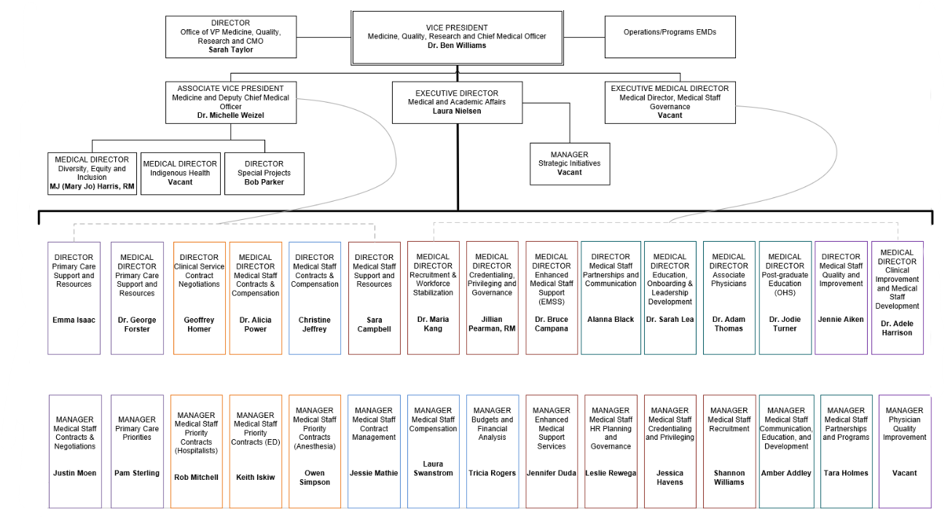
Medical & Academic Affairs (MAA)

Slide 9

Medical Staff Bylaws and Rules
Doctors of BC
Ministry of Health
  Contractually required to read and outline responsibilities between the Board of Directors, HAMAC and all medical staff.
Notes:
BYLAWS:
All medical staff are contractually required to read when they join Island Health.
Bylaws are put into effect by the IH Board of Directors and incorporate the requirements of the Hospital Act and the Health Authorities Act.
They require that the board appoint a Health Authority Medical Advisory Committee.
They require that the board appoint a Health Authority Medical Advisory Committee.
RULES:
The Medical Staff Rules (MSR) are established by the Board upon the recommendation of the Health Authority Medical Advisory Committee (HAMAC).
Govern the relationship between Island Health and address requirements laid out in the Hospital Act and its Regulation.
Address the accountability Medical Staff members have for their day-to-day practice.
Apply to all members of the Medical Staff whether they are independent Practitioners, contracted Practitioners, or employees.
As per the Bylaws, the Board, on the advice of HAMAC, will organize the Medical Staff into Departments, Divisions and Sections.
All members will belong to at least one Department and maintain privileges in at least one site.
MSR set out the responsibilities for HAMAC, as well as for the Local Medical Advisory Committees (LMACs).

Slide 10
Health Authority Medical Advisory Committee (HAMAC)
WHO
  Diverse membership—Dept. Heads, Chiefs of Staff, Medical Staff Association and Executive Medical Directors
  Co-Chaired by Jillian Pearman, RM and Dr. Brian Mc Ardle
What
  Makes recommendations directly to the Board of Directors and CEO
  Advises operational teams but does not advise Board on operational issues
  Endorses the work and recommendations of subcommittees
WHY
  Focus on the quality, effectiveness, and availability of medical care provided within Island Health facilities and programs

Slide 11
HAMAC Subcommittees
medical Planning & credentials Committee (MPCC)
Vacant
Medical Educational Resources Committee (MERC)
Dr. Sarah Lea
Legislative Committee (LC)
Vacant
Local Medical advisory committees (LMACs)
Co-chaired by Chiefs of Staff and Medical Directors at each site
Notes:
Medical Planning & Credentials Committee (MPCC)
-Medical Staff Human Resource Planning
-Medical Staff Recruitment
-Credentialing and Privileging
-Medical Staff Performance Enhancement
-Medical Staff Governance
Medical Educational Resources Committee (MERC)
-Identification and prioritization of learning needs, including rural community, Indigenous Health and cultural learning
-The planning, promotion, and coordination of continuing educational activities and informal learning opportunities, including Department-level tracking and evaluation
-Translation of provider quality assurance challenges into educational opportunities through the endorsement of evidence based and best practice learning
-Educational content on the Medical Staff website and Island Health Libraries
-Access to interdisciplinary educational opportunities, and learning opportunities through provincial initiatives
-Coordinated and focused learning opportunities for Medical Staff
-Medical Staff onboarding process and implementation
-Learning through an equity diversity and inclusion lens
Legislative Committee (LC)
-Development, implementation, monitoring and revision of the VIHA Medical Staff Rules and Policies
-Review and renewal of the Rules to reflect changes in the clinical-practice environment
-Review of legislation on the quality of medical care and/or the performance of Medical Staff
-Embedding the organizational culture within the Rules, including commitments to Diversity, Equity, Inclusion and Cultural Safety
The LMAC is a site-specific sub-committee of the HAMAC that fulfills the same duties and functions as HAMAC at the local level.
A site-based structure focused on medical staff cultural safety and quality, including optimal service delivery and operational efficiency within the hospital or acute site.
Escalates issues to Combined Local Health Area (CLHA) Operational and Excellence Committee as well as to relevant program C.A.R.E. Networks (e.g.; medicine, critical care, heart health).

Slide 12
HAMAC Subcommittees Cont’d
Local Medical advisory committees (LMACs)
Campbell River District Hospital | Dr. Dean Percy
Chemainus Health Care Centre | Dr. Tanis Morris
Comox Valley Hospital | Dr. Corey Tomlinson
Cowichan District Hospital | Dr. Graham Blackburn
Lady Minto Hospital | Dr. Anik Mommsen-Smith
Ladysmith Community Health Centre | Dr. Matthew Toom
Nanaimo Regional General Hospital | Dr. Mark James
Port McNeill and Port Hardy Hospitals | Dr. Evan Rogers
Saanich Peninsula Hospital | Dr. Brendon Irvine
South Island LMAs (VGH, GRH, RJH) | Drs. Chloe Lemire-Elmore, & Brian McArdle
Tofino General Hospital | Dr. Carrie Marshall
West Coast General Hospital | vacant
Notes:
Local Medical advisory committees (LMACS)
-Initial review of requests for Privileges at the site or sites within its jurisdictions
-Recruitment recommendations
-Site operations
-Medical staff occupational health and safety
-Quality improvement and assurance

Slide 13
Medical Staff Associations (MSAs)
11 Medical staff associations across Island health
forum
  Nanaimo Medical Staff Engagement Society
  Cowichan District Medical Society
  Campbell River Medical Staff Engagement Initiative Society
  Physician Engagement Society of Comox and Courtenay
  Lady Minto Gulf Island MSA
  Mount Waddington Facility Engagement Committee
  South Island MSA
  Saanich Peninsula Physician Society
  Tofino Medical Staff Engagement Society
  West Coast General MSA
  Alert Bay MSA
locally specific
Resources
Representation
connection
planning
Information
Engagement
REPORTING
Voice
support
MSAs are a groups of physicians and other medical professionals that work together to address issues and concerns related to patient care and the practice of medicine. They act as a voice for the medical staff and provide a platform for communication and collaboration with hospital administration and Island Health.
Notes:
MSAs consist of medical staff who have privileges at 11 sites
-Works closely with Doctors of BC
-To provide voice to the Medical Staff and to represent the views of its local ; why are they here/how they help physicians
-To provide a forum to inform and connect the Medical Staff
-To raise regional matters of significance with local administration and HAMAC
-To engage members on program and resource planning
-Report to HAMAC through HAMSA

Slide 14
MEDICAL & ACADEMIC AFFAIRS
PROGRAMS, PORTFOLIOS,
& INITIATIVES
Notes:
Explain difference
A site can do this, not that

Slide 15
Recruitment
WHO
  Dr. Maria Kang, Medical Director, Recruitment & Workforce Stabilization
  Sara Campbell, Director, Medical Staff Support and Resources
  Shannon Williams, Manager, Medical Staff Recruitment
What
  Human resource planning
  Assist departments with impact assessment and approval process for recruitment of physicians, midwives, and dentists
  Provide advice and support to ensure compliance with the recruitment policy
  Support search and selection processes
  Manage the Practice Ready Assessment and UBC IMG Return of Service programs

Slide 16
Contract Management
WHO
  Alicia Power, Medical Director, Medical Staff Contract & Compensation
  Sara Campbell, Director, Medical Staff Support and Resources
  Jessie Mathie, Manager, Medical Staff Contract Management
  Geoff Homer, Director, Special Projects, Primary Care
  Justin Moen, Manager, Primary Care
What
  Negotiate and prepare medical staff contracts for clinical, on-call (MOCAP), medical leadership and physician administrative services
  Process medical staff payments
  Facilitate medical staff contract management
  Provide stewardship for Ministry funds that support these services
Notes:
Geoff new
APP, MOCAP

Slide 17
Primary Care Support and Resources
WHO
  Dr. George Forster, Medical Director, Primary Care Support and Resources
  Emma Isaac, Director, Primary Care Support and Resources
  Justin Moen, Manager, Medical Staff Contracts and Negotiations
  Pam Sterling, Manager, Primary Care Priorities
What
  Advising about contract options for primary care services;
  Informing practitioners and partners about key contract deliverables;
  Ensuring a contract aligns with services and complies with provincial policies;
  Administering a contract through its life-cycle, from preparation through renewal; and
  Liaising with Ministry of Health, practitioners and partners to advance primary care initiatives
Notes:
Communication key thru covid
Developed robust newsletter and town hall, lots of engagement
Opportunities: news, members events, etc

Slide 18
Credentialing & Privileging
WHO
  Jill Pearman RM, Medical Director, Credentialing, Privileging & Governance
  Sara Campbell, Director, Medical Staff Support and Resources
  Jessica Havens, Manager, Medical Staff Credentialing & Privileging
What
  Specifics regarding individual medical staff credentialing and privileges
  Reports/directory (CACTUS) for medical staff
  Provider reappointment
  Category changes, leaves of absence, site changes and locum tenens
Notes:
Categories: understand (DH/SH), as well as LOA

Slide 19
Enhanced Medical Staff Support (EMSS)
WHO
  Dr. Bruce Campana, Medical Director, Enhanced Medical Staff Support
  Sara Campbell, Director, Medical Staff Support and Resources
  Jennifer Duda, Manager, Enhanced Medical Staff Support
  Daphne Van der Boom, HR Specialist, Enhanced Medical Staff Support
What
  Supports medical leaders in attending to professional/performance concerns of medical staff
  Helps resolve professional issues as they arise, and works proactively to enhance the capacity and ability of all leaders across the organization to understand, manage and resolve concerns
  Supportive and solutions-based, rather than punitive, if possible
Notes:
Support service available when issues arise around professionalism involving members of medical staff
Respectful workplace redirects
Supportive approach, non- punitive where possible
Contact for early guidance, advise,
Do not consider this as a ‘reporting’ process
-Tool kit with stages
MS concerns: DH or SH >>> DH or COS.

Slide 20
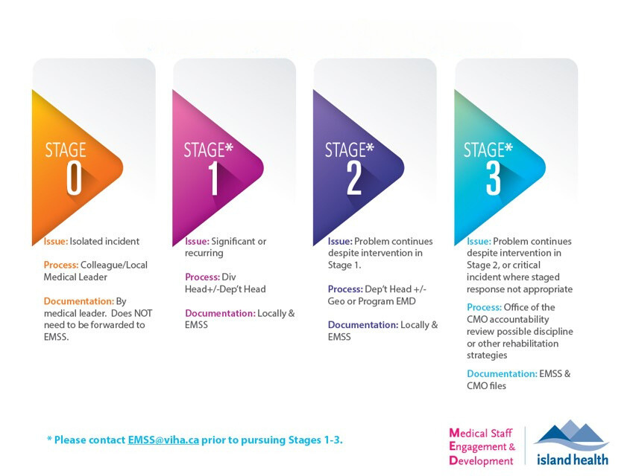
EMSS Stages of Concern
*Please contact EMSS@islandhealth.ca prior to pursuing stages 1-3
Notes:
Here is graphic explaining the stages of support and discipline.
Just remember that 0 is better than 3.
There are a fair number of 0s. Very few 2s and 3s.

Slide 21

External Funding for Physicians
Doctors of BC
Ministry of Health
Physician Master Agreement
(PMA)
Family
Practice
Services
Committee
(FPSC)
Shared
Care
Committee
(SCC)
Specialist
Services
Committee
(SSC)
Joint Standing
Committee on
Rural Issues
(JSC)
4 joint collaborative committees
PSP
PCNs
DoFP
Shared Care Partners for Patients
PQI
HSR
FEI
REAP
RCCBC-
RCME, Rural Liaison
Notes:
PQI: members directly to team (annual cohort recruitment)
FEI: MSA managed (rolling process?)
HSR: MAA managed (annual requests for project)
FPSC: FPSC works on behalf of doctors to strengthen full-service family practice and patient care in BC. It is one of four joint collaborative committees that represent a partnership of the Government of BC and Doctors of BC.
SCC: the Shared Care Committee has supported physicians, and partners, to work together on over 450 projects across BC. The mandate of this Joint Collaborative Committee (a partnership of Doctors of BC and the BC government), is to support family and specialist physicians to improve the coordination of care from family practice to specialist care.
SSC: SPECIALIST SERVICES COMMITTEE (SSC) improves patient care by engaging physicians to collaborate, lead quality improvement and deliver quality services with SSC supports and incentives. SSC is one of four joint collaborative committees of Doctors of BC and the BC government and includes regular representation from health authorities.
JSC: The Joint Standing Committee on Rural Issues (JSC) was established under the Rural Subsidiary Agreement (RSA) in 2001. It’s made up of representatives from Doctors of BC, the BC Ministry of Health, and the health authorities. The JSC advises the BC government and Doctors of BC on matters pertaining to rural medical practice. Its goal is to enhance the availability and stability of physician services in rural and remote areas of British Columbia by addressing the unique and challenging circumstances faced by physicians.
PSP: General Practice Services Committee Practice Support Program
The program offers focused, accredited training sessions for physicians and their medical office assistants (MOAs) to help them improve practice efficiency and to support enhanced delivery of patient care. The goals of the PSP are to improve physician professional satisfaction and patient access to, and quality of, care. Includes accredited learning modules in Patient Self-Management and Group Medical Visits and Health Literacy. Six- to eight-week action periods follow each learning session and are a time when PSP participants try out what they’ve learned in their own practice with the Regional Support Teams available to provide ongoing support.
PCNs: Primary Care Networks (PCNs) are a team-based approach to healthcare where a group of primary care providers, including physicians, work together within a defined geographic area to provide comprehensive and coordinated care to patients.
DoFP: Local divisions undertake various initiatives, projects, and programs to address specific areas of patient care, administration, and physician support. Division work on these initiatives helps to recruit new doctors, support specific patient populations (such as frail elderly patients and patients with mental health and substance use issues), and support doctors in practising more efficiently.
Shared Care Partners for Patients: Shared care partners for a patient typically include family physicians, specialists, and other healthcare professionals like pharmacists, nurses, and allied health professionals. These partners work collaboratively to provide comprehensive and coordinated care for the patient, especially those with chronic conditions.
PQI: Physician Quality Improvement (PQI) is a professional development and education program for Community or Facility-based Medical Staff who want to enhance their quality improvement capacity, build connections with colleagues, and create a continuous improvement culture to transform our local health system.
HSR: Health System Redesign (HSR) funding facilitates physician engagement and collaboration in the redesign and/or quality improvement of health services provided by Island Health.
FEI: Facility Engagement Initiative (FEI)Supports engagement amongst and between physicians and Island Health administrative leadership.
REAP: The Rural Education Action Plan (REAP) supports the training needs of physicians in rural practice and provides undergraduate medical students and post-graduate residents with rural practice experience. It also increases rural physician participation into the medical school selection process. REAP is managed by the Joint Standing Committee on Rural Issues and categorizes its programs by rural practitioners, residents and learners.
RCCBC -RCME, RURAL LIASION: The Rural Continuing Medical Education (RCME) Community and Individual Programs provide funding and other supports to rural doctors to update and enhance their medical skills and credentials required for rural practice.

Slide 22
Medical Staff Quality
WHO
  Dr. Adele Harrison, Medical Director, Clinical Improvement & Medical Staff Development
  Jennie Aitken, Director, Medical Staff Quality & Improvement
  Manager, Vacant
What
  Sepsis QI and Choosing Wisely Canada (Reducing Unnecessary Variation in Care)
  Good Call and Well-Planned (Team-based Action Series)
  Morbidity and Mortality Rounds
  Provider Profile
  Physician Quality Improvement
Notes:
MS specifically:
MAA teams above
Many projects/teams for MS focused QI

Slide 23
Physician Quality Improvement (PQI) &
Spreading Quality Improvement (SQI)
WHAT
  PQI is a professional development and education program for community or facility-based medical staff
  SQI is an initiative by the Specialist Services Committee (SSC). Allows medical staff to share their successful QI projects
WhY
  PQI is for medical staff who want to enhance their quality improvement capacity, build connections with colleagues, and create a continuous improvement culture
  SQI allows medical staff to accelerate the impact and transformation of the healthcare system. SQI offers fiscal and human resources to help spread successful QI projects locally, regionally, and beyond
Notes:
Currently enrolling my cohort. Not filled!
Best entry for new leaders.
For new graduates wanting to continue clinical research.

Slide 24
Physician Compensation
WHO
  Dr. Alicia Power, Medical Staff Contracts & Compensation
  Christine Jeffrey, Director, Medical Staff Contracts & Compensation
  Laura Swanstrom, Manager, Medical Staff Compensation
What
  Provide guidance on designing, developing, and describing medical staff services at Island Health
  Work in partnership with departments to find contract solutions for medical staff

Slide 25
RCME Community Program
What
  Provides funding and resources to groups of local physicians in eligible communities to support community education needs
  Funds may be used to compensate physicians for time spent developing and/or planning CME events
  Funds are not to be used to pay physicians for time spent participating in CME events
  Funds may be used to deliver activities involving other health care professionals
  Communities may accumulate up to 3 years of funds
  Up to 20% of annual funding can be used to fund a local coordinator position
Eligibility
  Physicians who reside and practice in eligible Rural Subsidiary Agreement (RSA) communities
  RSA Community Designation assessed on annual basis to determine total points
  “A” communities are the most remote and “D” communities are the least remote
For further information, please contact Bianca DeSilva, RCME Liaison: Bianca.DeSilva@islandhealth.ca
Notes:
Why does Program exist:
To support physician participation in medical education to update and/or enhance medical skills and credentials required in rural practice
To improve capacity of local health care systems to address needs of community:
• Gives physicians more control
• Reduces challenges
• Improves relationships within and across regions
Tailored for rural needs
Untapped community funds that need to be utilized
- Lack of physician capacity and administrative support to help plan/facilitate learning activities
Examples of Successful SMALLER CME activities:
- ADHD Medication in Adult􀀁s - Atrial Fibrillation
- Breast Cancer Update
LARGER CME activities:
- ACoRN Acute Care of at-Risk Newborns
- HOUSE Hands-on Ultrasound Education
- POCUS Point-of-Care Ultrasound
Opportunities:
• Exploring sharing of funds between communities
• Working with communities to find administrative support – potential for multi-community models
• Continue to support relationship building

Slide 26
Partnerships & Communication
WHO
  Alana Black, Director, Medical Staff Partnerships & Communication
  Dr. Sarah Lea, Medical Director, Education, Onboarding & Leadership Development
  Adam Thomas, Medical Director, Associate Physician Program
  Amber Addley, Manager, Medical Staff Communication, Education & Development
  Tara Holmes, Manager, Medical Staff Partnerships & Programs
What
  Medical staff communications including medical staff website, newsletters and bulletins, events calendar, town halls
  Develop and support systems navigation through orientation for medical leaders and medical staff; additional supports available for rural physicians
  Support departmental CPD rounds and other organizational education
  Advises on CME accreditation process
  Develops leadership development programing
  Promotes learning opportunities
  Administration of education funding
Notes:
Communication key thru covid
Developed robust newsletter and town hall, lots of engagement
Opportunities: news, members events, etc

Slide 27
Medical Leadership Development
WHO
  Dr. Sarah Lea, Medical Director, Education, Onboarding & Leadership Development
  Alanna Black, Director, Medical Staff Partnerships & Communication
  Amber Addley, Manager, Medical Staff Communication, Education and Development
What
  Internal medical leadership development workshops cover topics nominated by frontline medical staff leaders
  Topics selected to enhance skills and comfort level given the challenges of building a high performing healthcare system
  All workshops are eligible for both MOC Section 1 and Mainpro+ Continuing Medical Education (CME) credits
  Oversee our Medical Education Committee, to promote learning opportunities for medical staff and steward our medical staff education schedules

Slide 28
Medical Leadership Development (Cont.)
Current Learning Opportunities
Psychologically Safe Health Care Teams Virtual Workshop
  Hosted by Dr. Tom Lloyd and Dr. Dawn Martin
  The workshop aims to equip new medical leaders with the skills to promote and encourage psychologically safe environments in the workplace
  The workshop consists of four, 2-hour, virtual education sessions
  Medical staff members will be compensated at sessional rates while attending the workshop sessions
NEXT Session: September 2025
Email MedStaffPrograms@islandhealth.ca for more information or registration
co-funded via the Memorandum of Agreement (MOA) on Physician Psychological and Physical Safety.

Slide 29
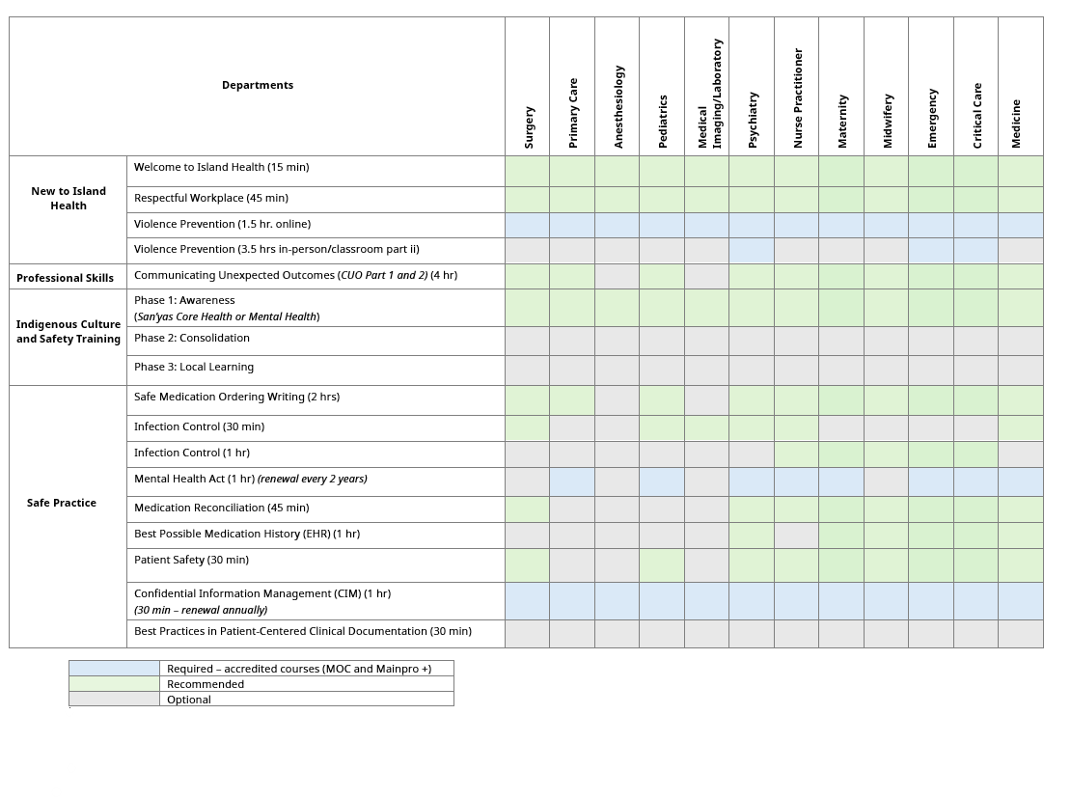
Department Education Schedules

Slide 30
Education Schedule
New to Island Health
  Welcome to Island Health
  Respectful Workplace
  Violence Prevention (online)
  Violence Prevention (classroom part ii)
Professional Skills
  Communicating Unexpected Outcomes
Cultural Safety and Humility
  Phase 1: Awareness
  Phase 2: Consolidation
  Phase 3: Local Learning

Slide 31
Education Schedule Cont’d
Safe Practice
  Safe Medication Order Writing
  Infection Control (30m)
  Infection Control (1hr)
  Mental Health Act
  Medication Reconciliation
  Best Possible Medication History
  Patient Safety
  Confidential Information Management
  Best Practices in Patient-Centered Clinical Documentation

Slide 32
Cultural Safety and Indigenous Training
Training Opportunity
San’yas Core Health or Core Mental Health
San'yas is a facilitated online training program that introduces participants to key aspects of Indigenous cultural safety and the importance of addressing Indigenous-specific racism. ​Recommended to all medical staff.
Bystander To Ally - Core Health or Core Mental Health​ course is a pre-requisite
Seven Generations: We highly recommend the Seven Generations course available on our LearningHub​.
Cultural Safety: Island Health Intranet Page​

Slide 33
NEW
Physician Health, Safety & Wellness
  Island Health works closely with Doctors of BC, MSAs, and the Ministry of Health to provide physicians with health and safety resources and support
  Provincial Physician Health & Safety Working Group (PPHSWG) provides a funding structure to enhance provincial alignment, encourage shared learning, and increase overall efficiency and impact across Health Organizations outlined in the Memorandum of Agreement (MOA) on Physical and Psychological Health and Safety in the 2022 Physician Master Agreement (PMA).
  Island Health is currently working with provincial partners to develop and improve:
o Violence prevention training programs
o Respectful workplace processes
o Workplace incident reporting processes
o Equity, diversity and inclusion collaborations

Slide 34
ISLAND HEALTH IMPROVEMENT INITIATIVES

Slide 35
Quality Structures
WHO
  Dr. Jeff Kerrie, Executive Medical Director, Quality, Safety, Improvement, Risk, Experience & Research
  Dr. Ali Yakhshi Tafti, Patient Safety, Patient Care Quality Office & Risk
Patient Care Quality Office (PCQO)
  PCQO provides an accessible and transparent point of contact for patients, family members and /or their representatives to share feedback, compliments, obtain clarification and information, and to resolve concerns about quality of care received
  The BC PSLS is a web-based reporting tool that helps healthcare providers manage patient safety events and share lessons learned to improved patients’ safety and quality of care
Patient Safety Learning System (PSLS)

Slide 36
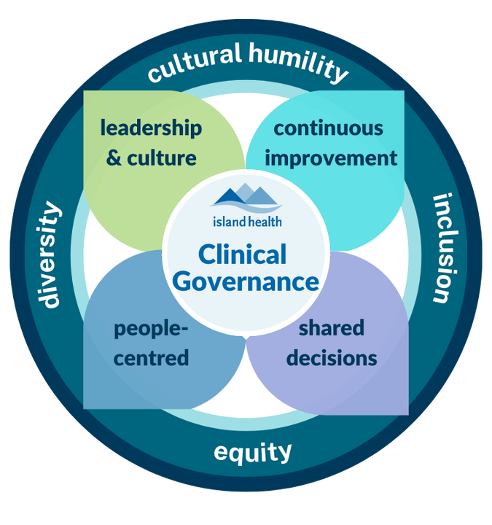
Clinical Governance Improvement Initiative (CGII)
  CGII is the structure of quality committees in Island Health. It allows for effective and transparent quality-focused decision making
Notes:
C.A.R.E. Networks are regional structures responsible for defining, monitoring, and enabling quality within specific services (e.g. Emergency) across Island Health
Within local regions, Island Health is split into 9 service delivery areas, called Consolidated Local Health Areas (CLHAs)
Each region supports 3 core committees:
o Integrated Quality & Operations Council
o Local Acute Quality & Operations Council
o Local Community Services Quality & Operations Council
The LMAC is a site-specific sub-committee of the HAMAC that fulfills the same duties and functions as HAMAC at the local level.
A site-based structure focused on medical staff cultural safety and quality, including optimal service delivery and operational efficiency within the hospital or acute site.
Escalates issues to Combined Local Health Area (CLHA) Operational and Excellence Committee as well as to relevant program C.A.R.E. Networks (e.g.; medicine, critical care, heart health).

Slide 37
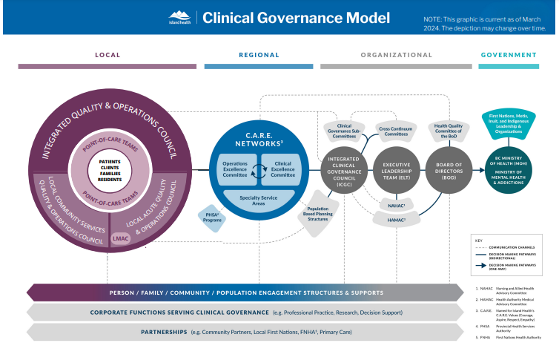
Clinical Governance Model
LMACS
Notes:
NOTES:
C.A.R.E. Networks are regional structures responsible for defining, monitoring, and enabling quality within specific services (e.g. Emergency) across Island Health
Within local regions, Island Health is split into 9 service delivery areas, called Consolidated Local Health Areas (CLHAs)
Each region supports 3 core committees: add all three to notes to slide 39.
Integrated Quality & Operations Council
Local Acute Quality & Operations Council
Local Community Services Quality & Operations Council

Slide 38
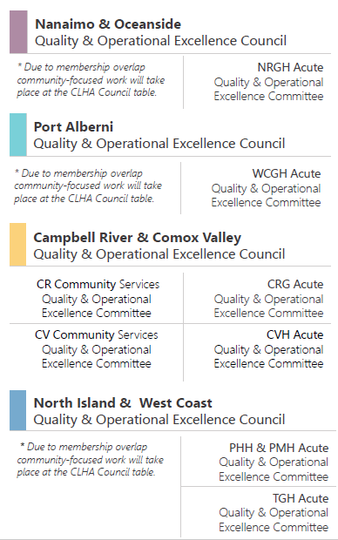
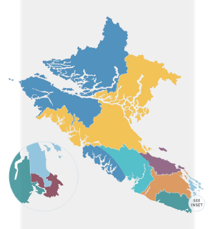
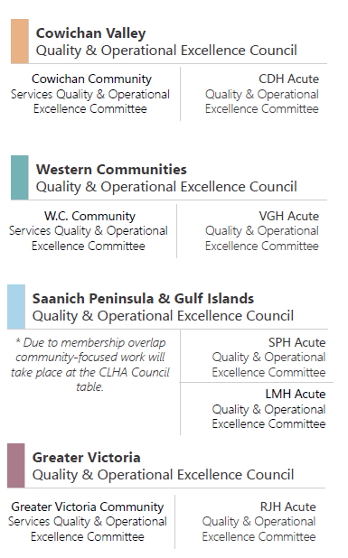

Local Clinical Governance Structure

Slide 39
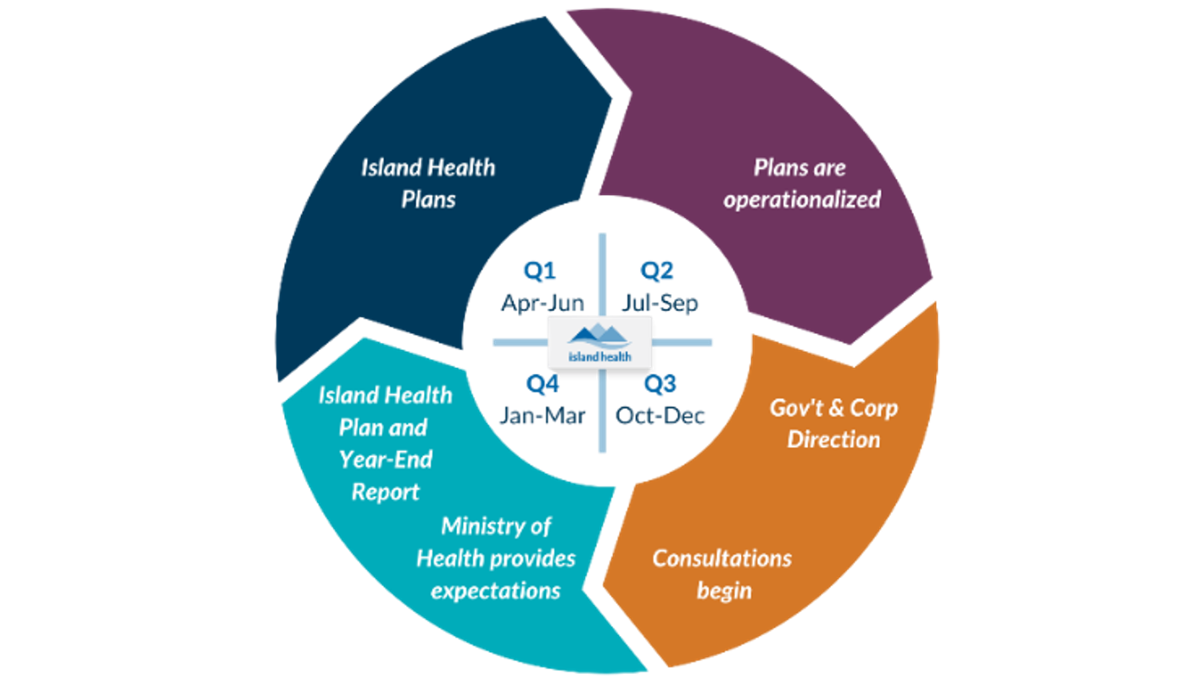
Direction Setting—Strategic Planning
Notes:
Update!
Direction setting documentation:
- Ministry of Health Strategic plan
- Government strategic plan
- Bilateral meeting with CEO
- Government mandate
- Island Health Strategic Priorities

Slide 40
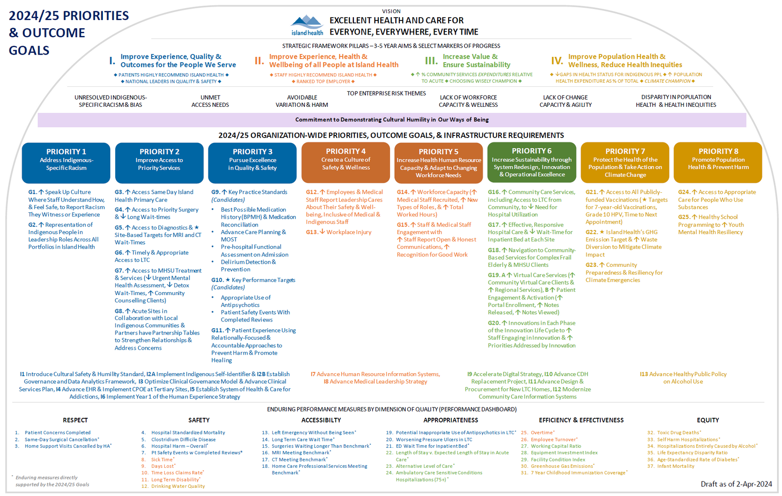
2024/25 Priorities & Outcome Goals
Notes:
Loaf goes here

Slide 41
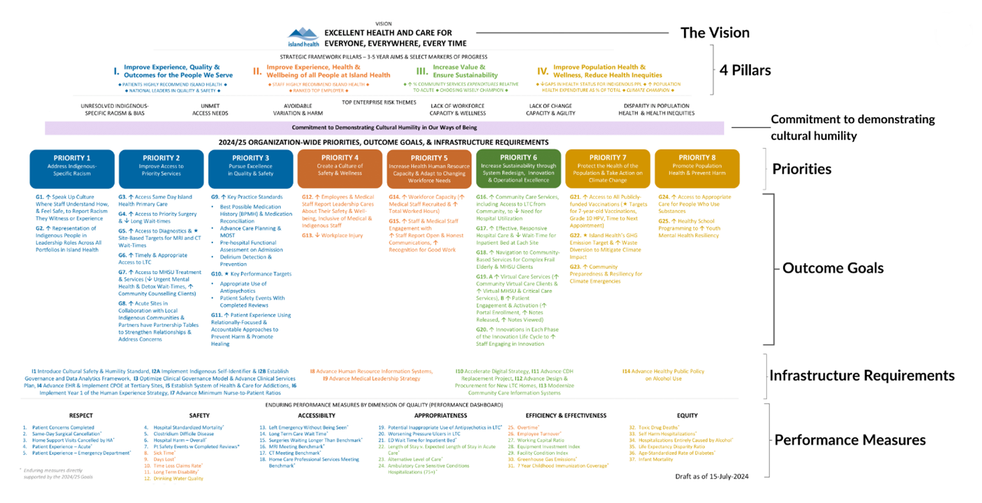
2024/25 Priorities & Outcome Goals (Cont.)
Notes:
Loaf goes here

Slide 42
CONTACT:
Medical Staff Communication, Education & Development
MedStaffDevelopment@islandhealth.ca
THANK YOU FOR YOUR LEADERSHIP
Notes:
Ongoing System Navigation
[Jennifer]
Contact us
Slides available on website
Send survey
Continuing to enhance materials so please use this as a hub for your information needs
And please reach out at any point – as mentioned earlier we are a contact for you thorough your tenure
(Complementary handbook for today's presentation)

