Slide 1

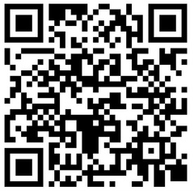





Are you a physician, a midwife or a nurse practitioner?
NEED TO RAISE AN ISSUE OR GET SUPPORT?
Your First Point of Contact:
or
Medical Leadership
Directory
Site Chief
Medical Lead
E.g. Site Chief, Emergency Medicine
E.g. Medical Lead, Imaging Medicine
Oversees a service/unit at your site
Oversees an area of care across multiple sites
Know your unit medical leader, get help with:
  “I have an improvement idea”
  “Our equipment needs repairs”
  “I need to request a leave of absence”
  “I have a disagreement with a physician colleague”
  and more…
Additional Contacts
1
Your Unit Manager
  Manages local PSLS and PCQO cases
  Key contact related to nurses and other staff
2
[Name], Chief of Staff
  Leads Site Chiefs and oversees hospital operations
3
[Name], Medical Staff Association President
  Foster the connection between medical staff and IH administration
  Advocates for medical staff at large and supports individual members
  Key contact for Facility Engagement funding
More information about Medical Leadership structure and changes:
Visit: Medicalstaff.islandhealth.ca/medical-leadership-strategy
Contact: MedicalLeadership@islandhealth.ca

